Slide 1
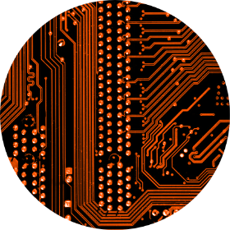
The CBM Process for PCB
Better HF properties, new materials.
Peter Sjöbeck, CEO
peter.sjobeck@cuptronic.com
Mobile: +46 - 70 730 0000
Dr. Björn Atthoff, CTO
bjorn.atthoff@cuptronic.com
Mobile: +46 - 70 996 6118
Non confidential
Notes:
My name is Peter Sjobeck and I come from a Swedish company called Cuptronic Technology.
Thank you for inviting me to give this presentation.

Slide 2
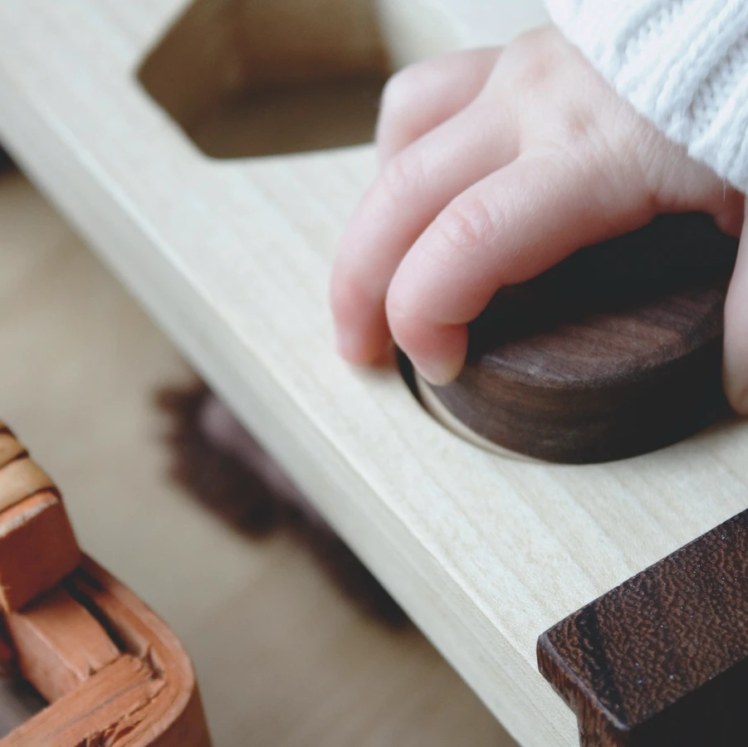

Our unique solution
A new chemical process, an adhesion promotion,
for attaching metal on non-metallic materials
Easy to implement
Enhances performance
Notes:
The CBM process (Covalent Bonded Metallization) is a revolutionary new way of attaching metals like Copper, Nickel, Silver and Gold to a variety of surfaces.
It is easy to implement, and enhances performance.
Today’s technologies for metal-adhesion to non-metallic surfaces rely mainly on mechanical adhesion by first creating a rough surface (down into the surface).
Current technologies have several issues, three of which being choice of materials, production cost and the use of Chrome+6 for etching.
The CBM process solves there problems.

Slide 3
Covalent Bonded Metallization
The CBM© Process
1
2
3
4
Spray/dip
CBM chemicals
Expose to
UV light
Activated surface structures
Apply Palladium and electroless
Cu or Ni
Notes:
The CBM process is very simple.
You apply the CBM chemical by spray or dip, and thereafter you expose it to UV light.
That is it.
Before you continue to standard Electroless Cu or Ni, you wash the pieces with cold water.

Slide 4
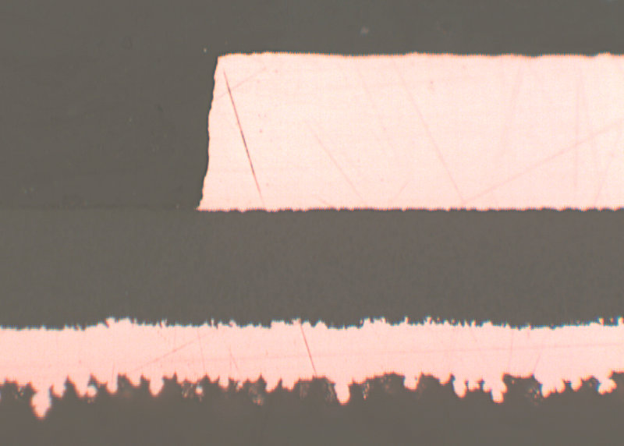
CBM Process Adhesion vs Standard Adhesion
18 µm electroplated Cu
CBM Process (≈ 50 nm)
+ 0,1 µm electroless Cu
15 µm GX-13©
Etched standard base Cu

Slide 5
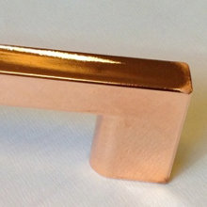
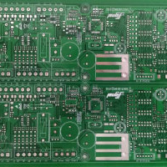
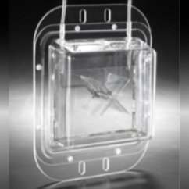
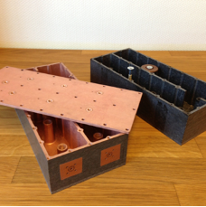
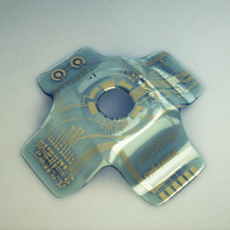

CBM solves problems in many areas
Plating on Plastic
Allows for metallization on a wide variety of plastics in a multitude of shapes
EMP/EMI shielding
Allows metalization on materials ranging from micrometer thick foils up to large 3D structures
PCB properties
Allows the production of very advanced circuit boards, high frequency, advanced patterns, narrow lines and spaces.
New materials
Allows for metalization of a multitude of plastics
Replace metal to plastic
Allows the reduction of weight by replacing metals to plastics
Selective 3D metallization
No ablation, new materials

Slide 6
Evaluated PCB materials
Plastic | Product name | N/cm | Lbs/in
Certain epoxy (HFFR4) |  | 15 | 8.6
PTFE | Taconic TLP 5 Taconic TLX 9 Nelco N9000 Rogers 3003 Rogers CLTE-MW | 25 >50 20 25 20 | 14.3 >28 11.4 14.3 11.4
LCP | Rogers Ultralam 3850 | 10 | 5.7
PI |  | 15 | 8.6
COC (Cyclic Olefin Copolymer) | transparent | 15 | 8.6
Peel Strength according to IPC-TM-650 2.4.8 (1 oz Cu), after solder float

Slide 7
Evaluated Rogers PCB materials
Rogers base laminates | CBM technology peeltests (N/cm) | N/mm | Lbs/in
 | Initial values | After 20 s solder shock x3 | 105°C for 2 weeks
RO3003 | 20,2 | 16,3 | 9,6
RO3010 | 17,2 | 16,1 | 17,3
RO4835 10mil | 9,2 | 8,5 | 7,6
RO4835 10,7mil | 7,5 | 9 | 8,5
CLTE-AT RL | 13,9 | 13 | 15,6
CLTE-AT RT | 9,6 | 9,6 | 9,8
CLTE-AT ED | 10,3 | 17,2 | 10,8
RT/duroid 6002 | 25,3 | 26,1 | 26,8
RT/duroid 5880 | 22,5 | 22,6 | 14,3
TMM3 | 12,2 | 10,5 | 11,5
TMM4 | 11,1 | 11,3 | 12,9
TMM6 | 9,7 | 8.5 | 10
TMM10 | 8,9 | 8,6 | 9,4
TMM10I | 9,2 | 9 | 11,1
AS300C | 26,7 | 20,7 | 31,1
More or less base material breach
Only base material breach

Slide 8
Evaluated POP materials. (several non-plating grade)
Plastic | Product name | N/cm | Lbs/in
PC/ABS | Cycoloy C1200 | 9 | 5.1
PC |  | 1 | 0.6
ABS | Novodur P2MC HI 121 H Recycled ABS: 50% LG TR558AI & 50% TERLURAN HI10 | 15 14 12 | 8.6 8.0 6.8
PLA filled with hemp | Trifilon Switch | 10 | 5.7
ASA |  | 13 | 7.4
PP |  | 30 | 17.1
PA 6 | Minlon 73M40 NC Grilon BS Natural Promyde B30 NC 100 Badamide B70GF30 | 40 40 20 20 | 22.8 22.8 11.4 11.4
PA 6,6 | Leona 91G60 | 15 | 8.6
PA 12 | Grilamid LV65H | 20 | 11.4
TR90 (PA) |  | 40 | 22.8
TPE |  | 20 | 11.4
PEI | Ultem 3452 | 8 | 4.6
Peel Strength according to IPC-650 and ASTM standard (1 oz Cu)
Notes:
These are a few of the materials we have tested for different customers.
The list increases for every month.

Slide 9
CBM Process features
“Simple” - Apply chemistry and UV light
CBM chemistry - Low cost
Applicable on a variety of new materials
Able to metallize very thin, and smooth substrates
High adhesion
Can be installed as parallel line, or other location

Slide 10
PCB

Slide 11
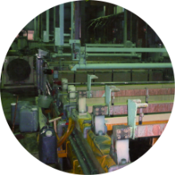
The CBM advantage
The CBM® Process chemically alters the surface to enable electroless metal deposition, i.e. on a smooth surface.
Metal adhesion technologies today are mainly mechanical and use dendrites to achieve adhesion to the surface.

Slide 12
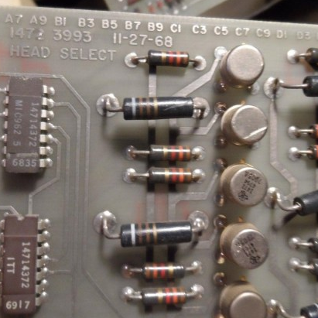
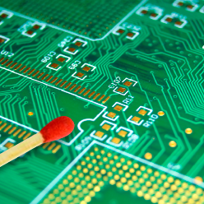
PCB: Better performance
1970s
2020s
As tracks shrink and frequencies rise, higher precison becomes key.

Slide 13
PCB trace line manufacturing
Using CBM Process results in better high frequency properties,
due to no under etching and no “tabs” on Base copper holding the copper in place.
Conventional process
Using CBM Process
Unit = µm
30
25
18
2

Slide 14
CBM in surface and holes
Conventional process
Cuptronic process
Mechanically
attached 18 µm Cu
Electroplated Cu
Cuptronic process +
Electroless 0,2 µm Cu
Substrate
No teeth/tabs

Slide 15
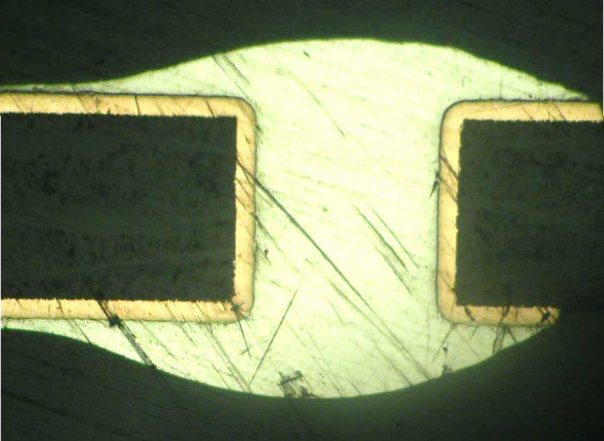
CBM in surface and holes
Rogers substrate after solder chock

Slide 16
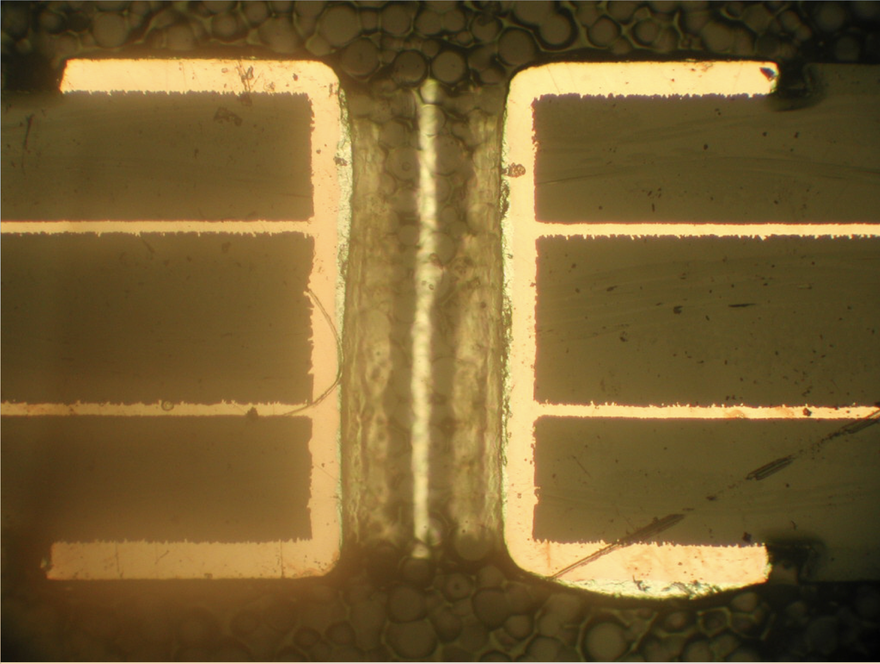
CBM in inter layer connection
Rogers substrate after solder chock

Slide 17
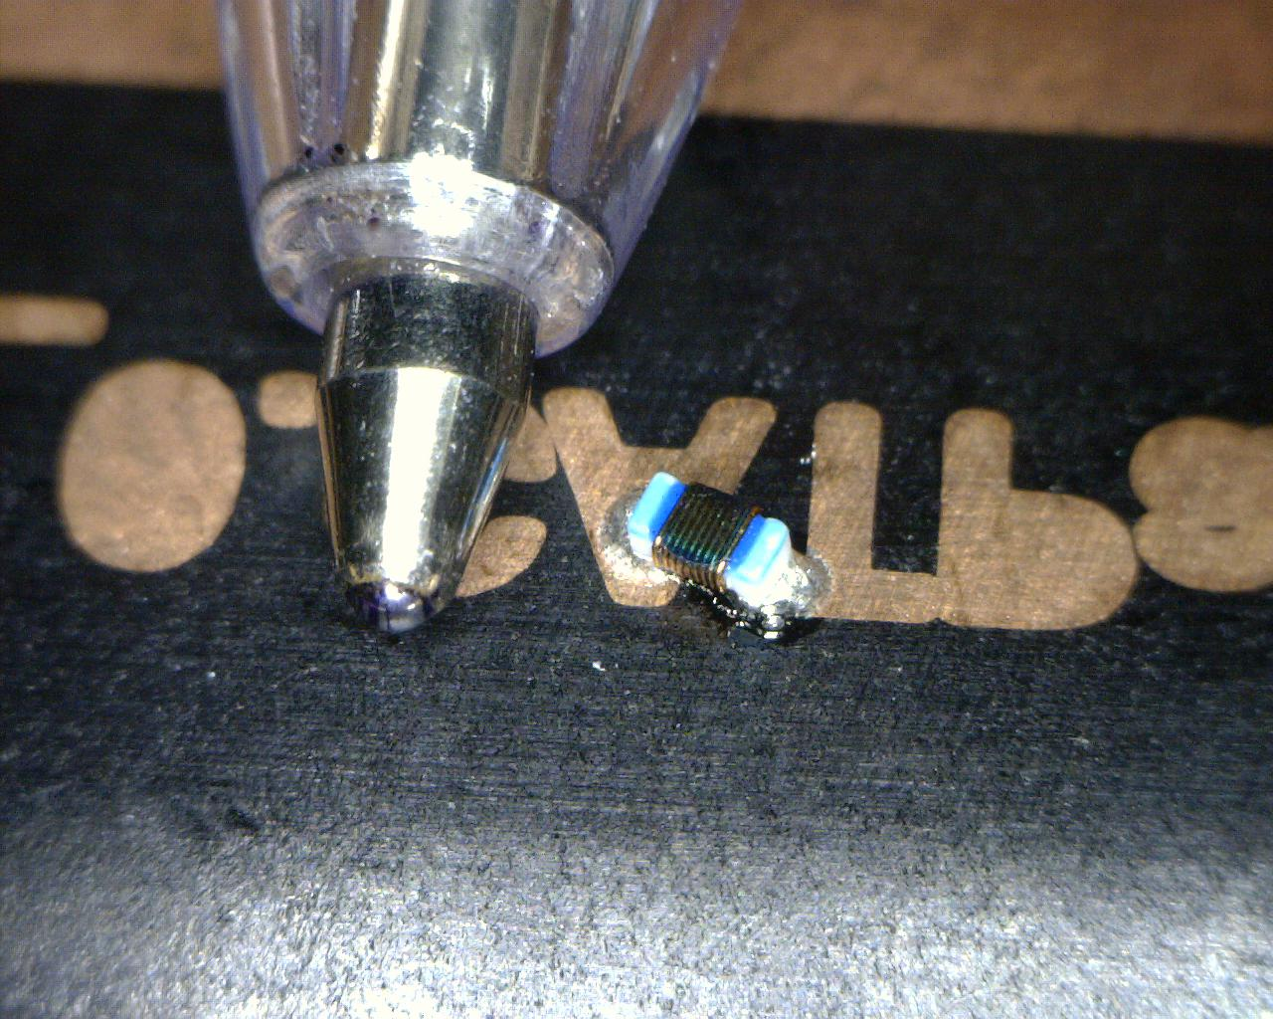
Full Additive 3D with Laser - Solder
Soldering on PA-6
Picture by Laird Technology

Slide 18
CBM in a PCB process
Drill panel
Pre-treatment of panel (if necessary, e.g. if hydrophobic)
Pre-wash
Drying
Application of Cuptronic chemistry (spray, dip, roll, conveyor)
Curing of Cuptronic chemistry (UV light conveyor)
New equipment for
a PCB manufacturer
Washing
Activation and reduction of palladium (or silver)
Electroless copper deposit
Drying

Slide 19
Flow Diagram – conventional PCB process
Drilling of
through- and
blind holes
Electroless
Cu
Imaging
Exposing
Developing
Degreasing
Rinsing
Microetching
Rinsing
Acid dipping
Electrolytical
copper
plating
Rinsing
Acid dipping
Tin plating
Rinsing
Stripping
of dry film
Rinsing
18 µm
Etching of
base copper
Rinsing
Stripping
of tin
Rinsing
Drying
Microetching of
conductors
Application of
soldermask
Further in
the process

Slide 20
Flow Diagram – with CBM Process
eliminated
Drilling of
through- and
blind holes
CBM Process
grafting
Electroless
Cu
Imaging
Exposing
Developing
Degreasing
Rinsing
Microetching
Rinsing
Substrate without base Cu
≈ 0.1 µm Cu
Acid dipping
Electrolytical
copper
plating
Rinsing
Acid dipping
Tin plating
Rinsing
Stripping
of dry film
Rinsing
Etching of
base copper
Rinsing
Stripping
of tin
Rinsing
Drying
Microetching of
Conductors,
Incl. etching of Base Cu
Application of
soldermask
Further in
the process

Slide 21
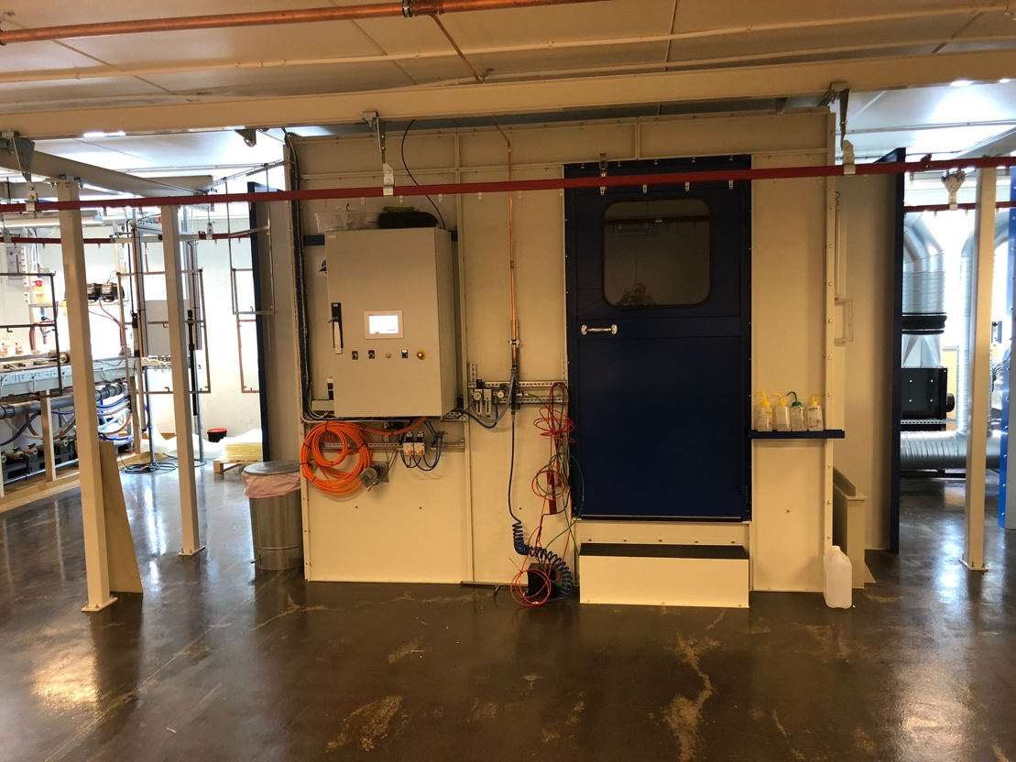
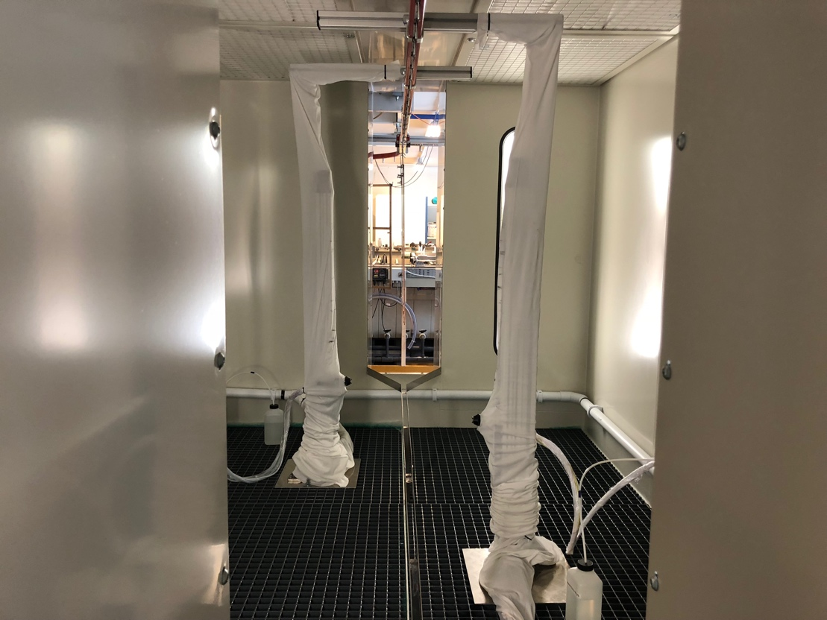
Lab implementation of CBM Process
Application of CBM chemistry
Conveyorized R&D line for PCB 18 x 24 inch panels.
Application of CBM Process chemistry on both sides.
Capacity: 50,000 panels/month.

Slide 22
Some Projects
Notes:
I will now show four different projects utilising our CBM process

Slide 23
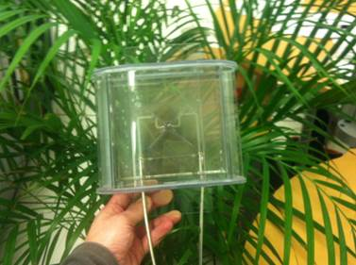
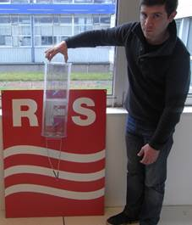
RFS’s AllClear Antennas
Problem: 85% of building owners say no to antennas due to unsightly visuals.
Solution: Transparent Antennas with C.O.C. plastic.
Case

Slide 24
RFS’s AllClear antenna installations

Slide 25
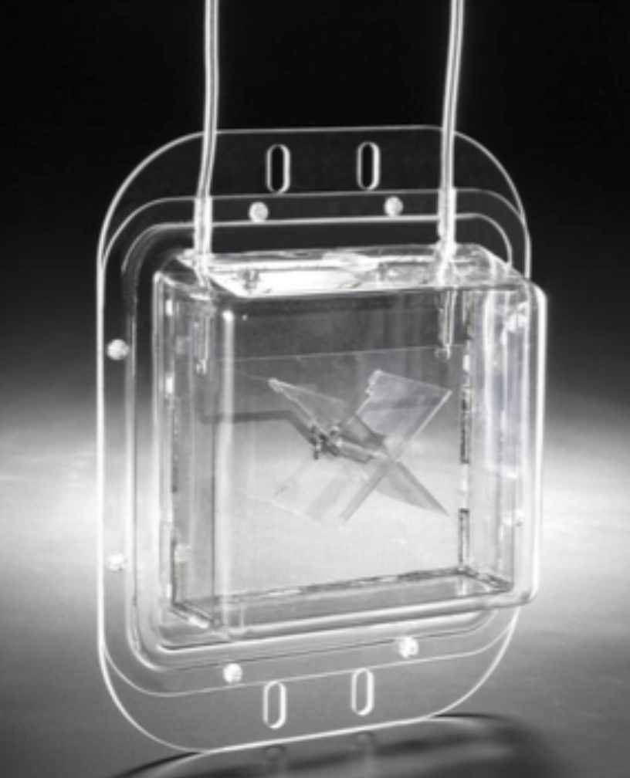
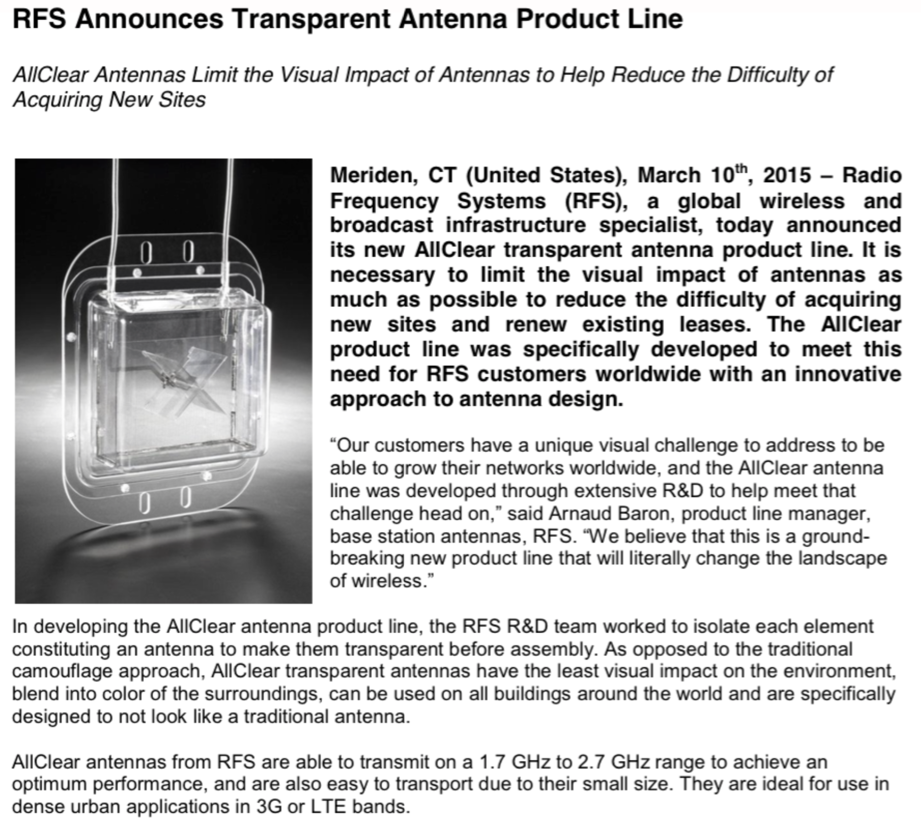
AllClear Antennas RFS (Alcatel-Lucent)
Problem: 85% of building owners say no to antennas due to unsightly visuals.
Solution: Transparent Antennas made from C.O.C. plastic.
Case
Notes:
RFS wanted to create a transparent antenna because 85% of the property owners in France did not want to continue to lease their properties to telecom companies for their mobile antennas because of visual pollution.
We help them find a transparent plastic which works very good with our CBM process.

Slide 26
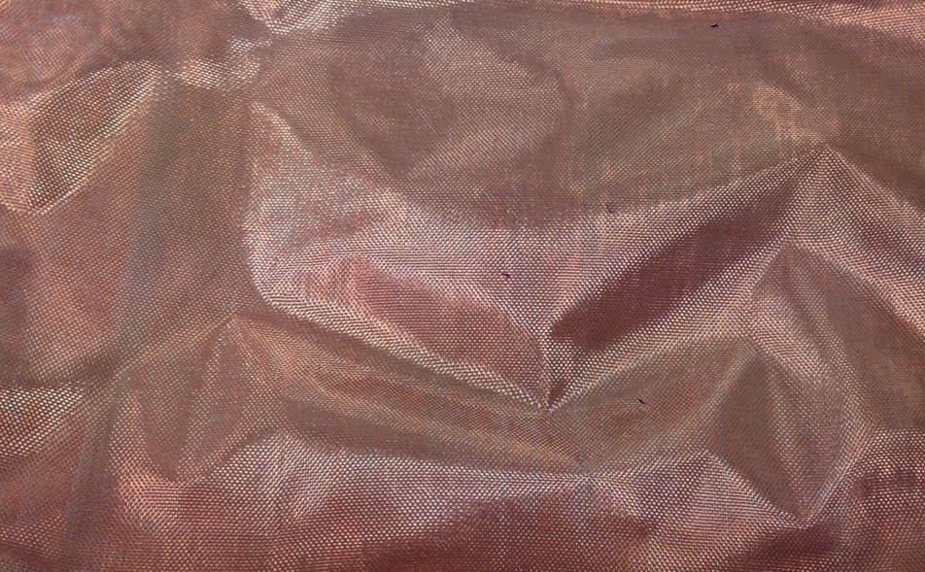
EMP/EMI Shielding (Samsung)
Problem: Thinner shielding materials.
Solution: Substitute textile EMI shielding (1 mm) with a metalized PET film (0.05 mm).
Case
1 mm textile with Copper
10 µm PET film with 2 x 20 µm Cu

Slide 27
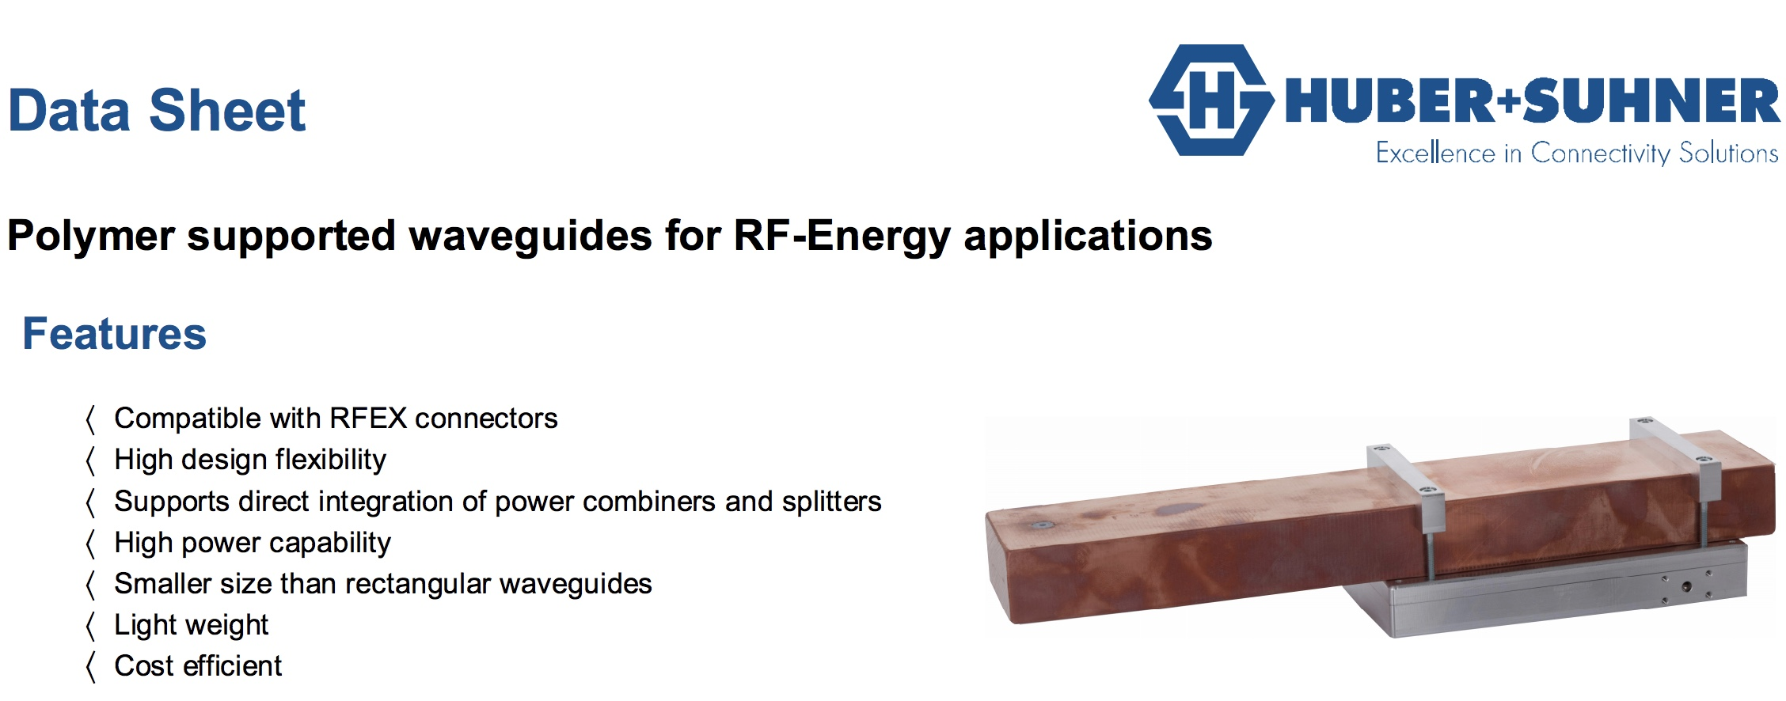
Plastic waveguides (Huber+Suhner)
Requirement: Reduce size, weight and cost of waveguides.
Solution: Metallized C.O.C plastic.
Case

Slide 28
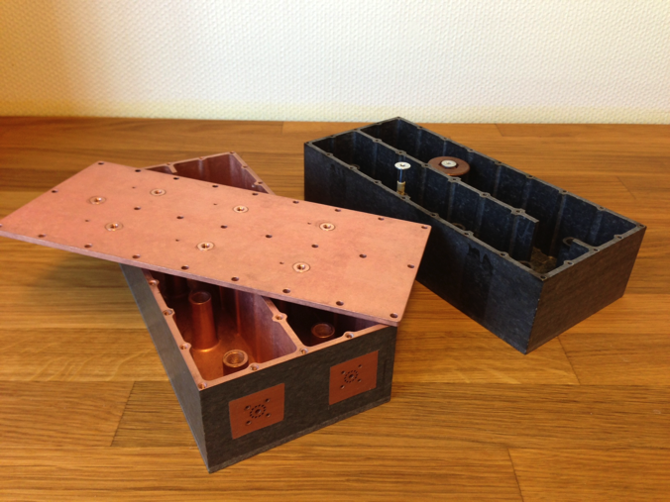
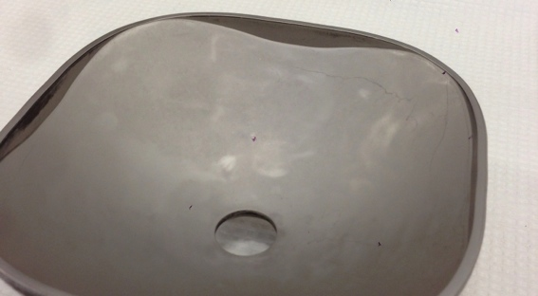
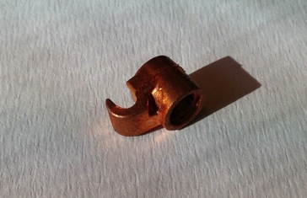
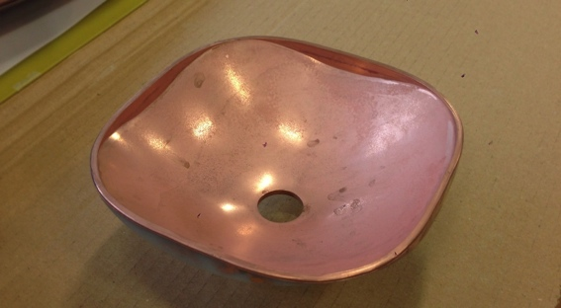
RFS/Alcatel, Lucent and others
Requirement: Reduce weight and decrease production cost.
Solution: Substitute metal components with metallized reinforced plastics.
Case
Telecom - Air cavity filters
From aluminum to metalized plastic
(GE ULTEM® 3452)
RFS/Alcatel’s connectors
From brass to metalized plastic
RFS/Alcatel’s antennas
From metal to metalized plastic

Slide 29
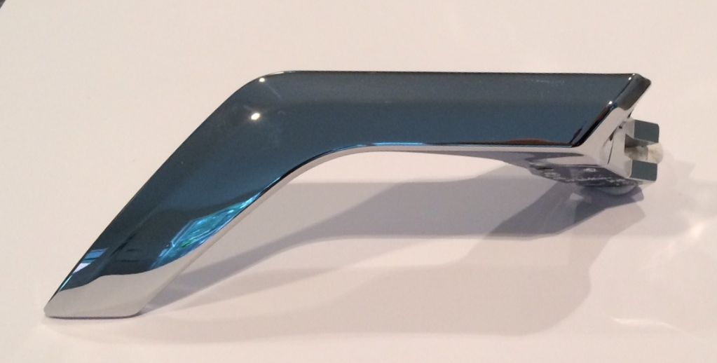
Car door handles (SKODA)
Requirement: Wear and tear resistant metallized plastic without Cr(VI) etching.
Solution: CBM Process applied to reinforced plastic.
Case
Minlon® 73M40 NC - 40% mineral reinforced PA6
No restriction on the type of fillers in the polymer, allows for better mechanical properties.

Slide 30
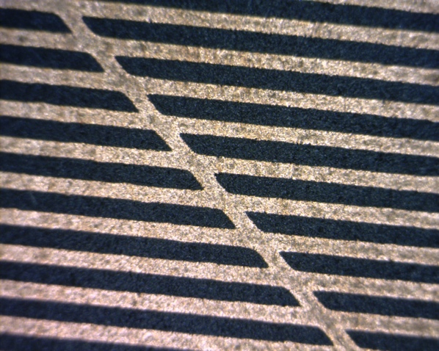
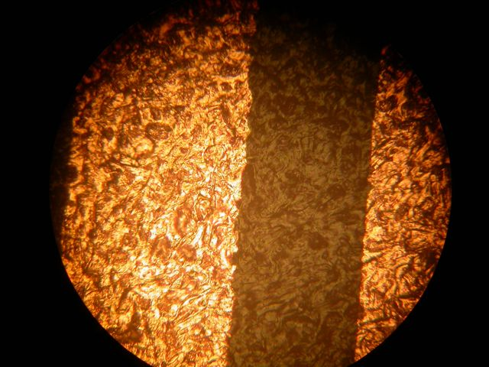
Selective metallization – 3D MID (LDS)
Requirement: Selective metallization on 3D parts
Solution: Either with UV-laser, Inkjet, or even better with Pad-printing.
Case
3 Methods
UV - Laser (apply CBM chemistry, design with laser)
Inkjet (apply design with Inkjet printer)
PAD printing (apply design with PAD printer)
Advantages
Cheaper materials with better properties can be used
Smooth surface under copper traces
Excellent edge definition
No creation of dust
E-less Copper lines on PA-6

Slide 31
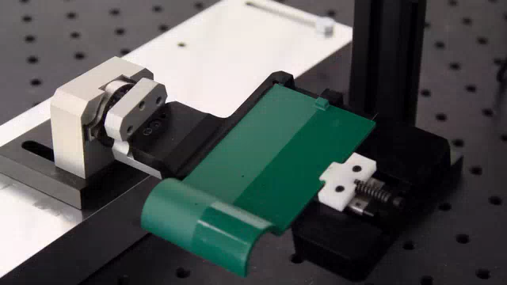
Selective metallization – 3D MID (LDS)
Requirement: Selective metallization on 3D parts
Solution: CBM process and activated (design) with UV-laser
Case
VIDEO

Slide 32
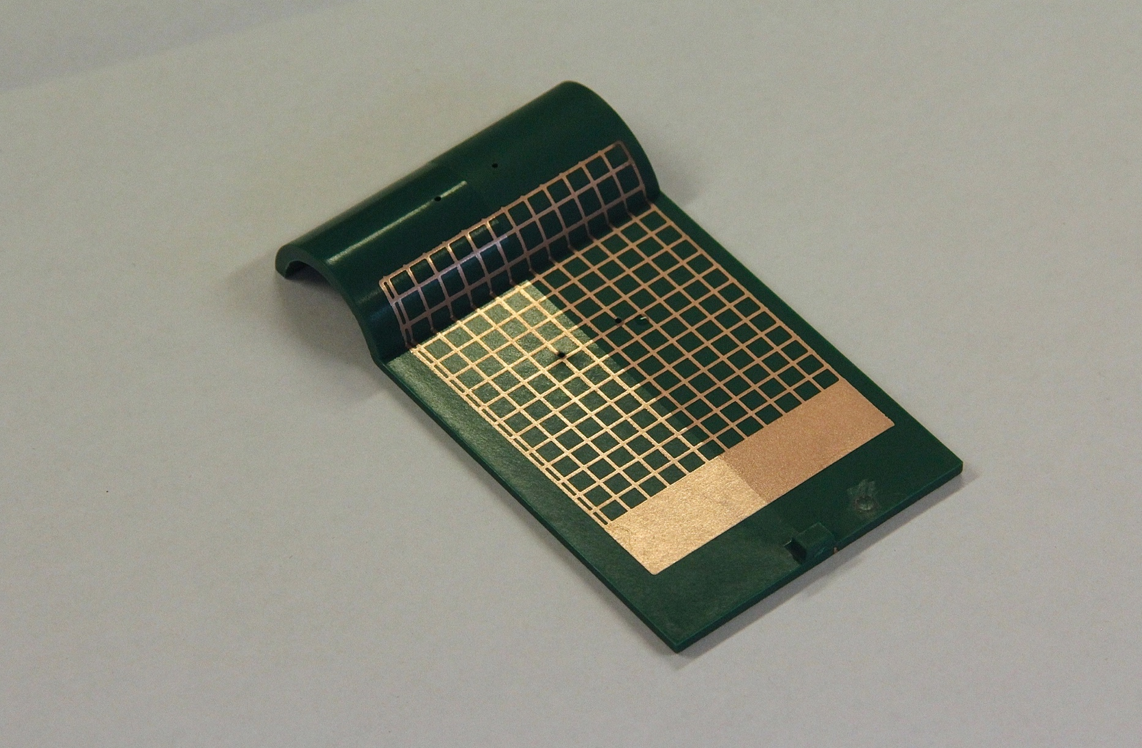
Selective metallization – 3D MID (LDS)
Requirement: Selective metallization on 3D parts
Solution: CBM process and activated (design) with UV-laser
Case
Result of previous
VIDEO

Slide 33
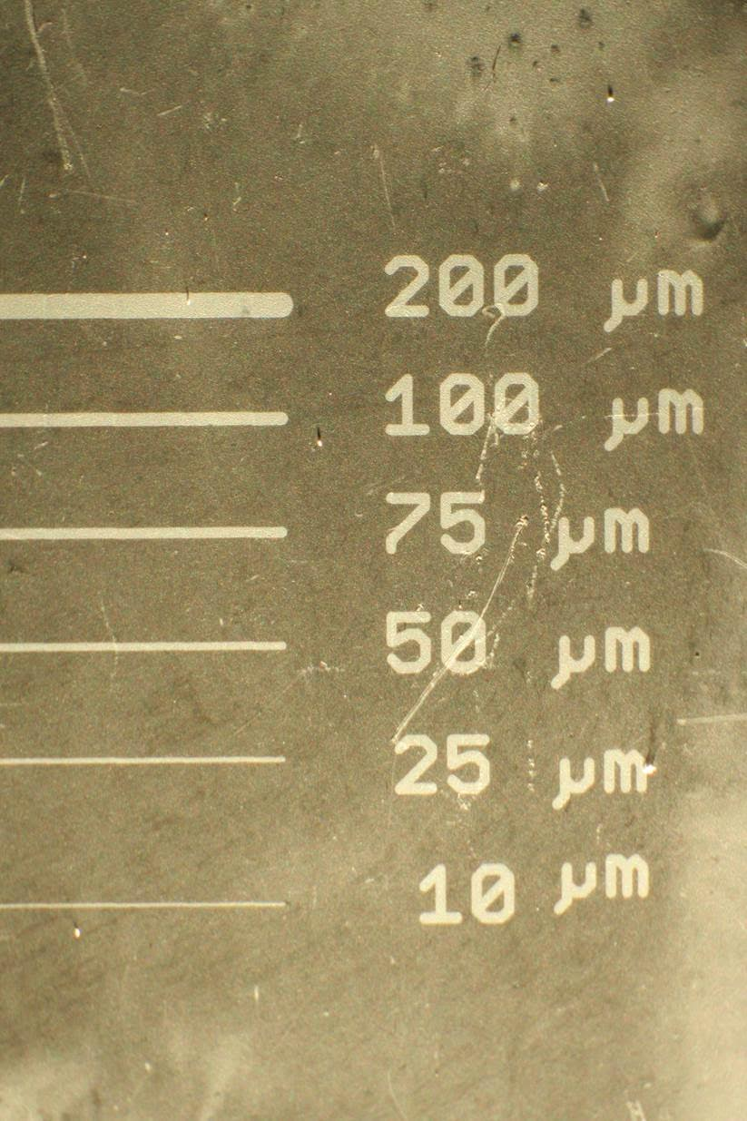
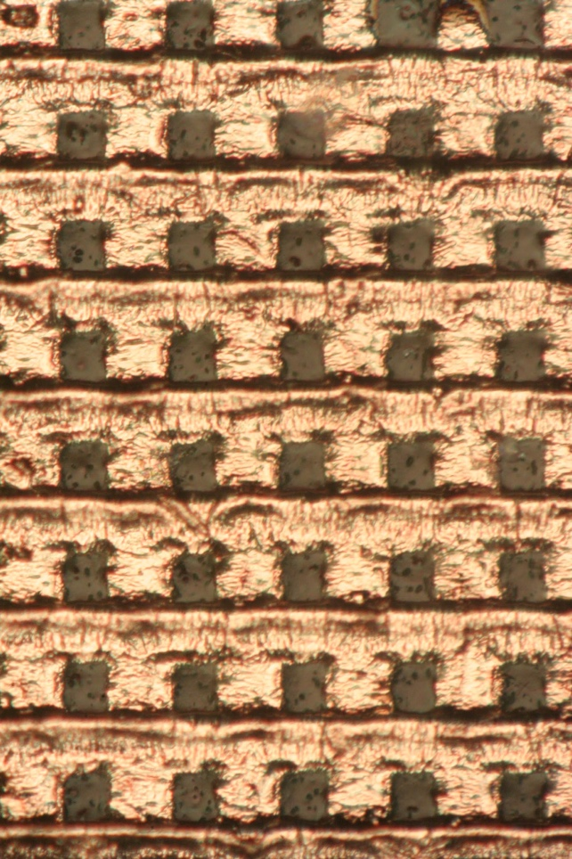
Selective metallization – 3D MID (LDS)
Requirement: Selective metallization on 3D parts
Solution: CBM process and activated (design) with UV-laser
Case
CBM chemistry applied on whole surface and lines defined (activated) by laser.
Line width limited primarily by equipment used to define lines. Target is 1 µm lines.
Laser line definition process currently only implemented in lab environment.
Courtesy of Prof. Delsing,
Luleå University of Technology.
Multiple line widths
7 µm lines

Slide 34
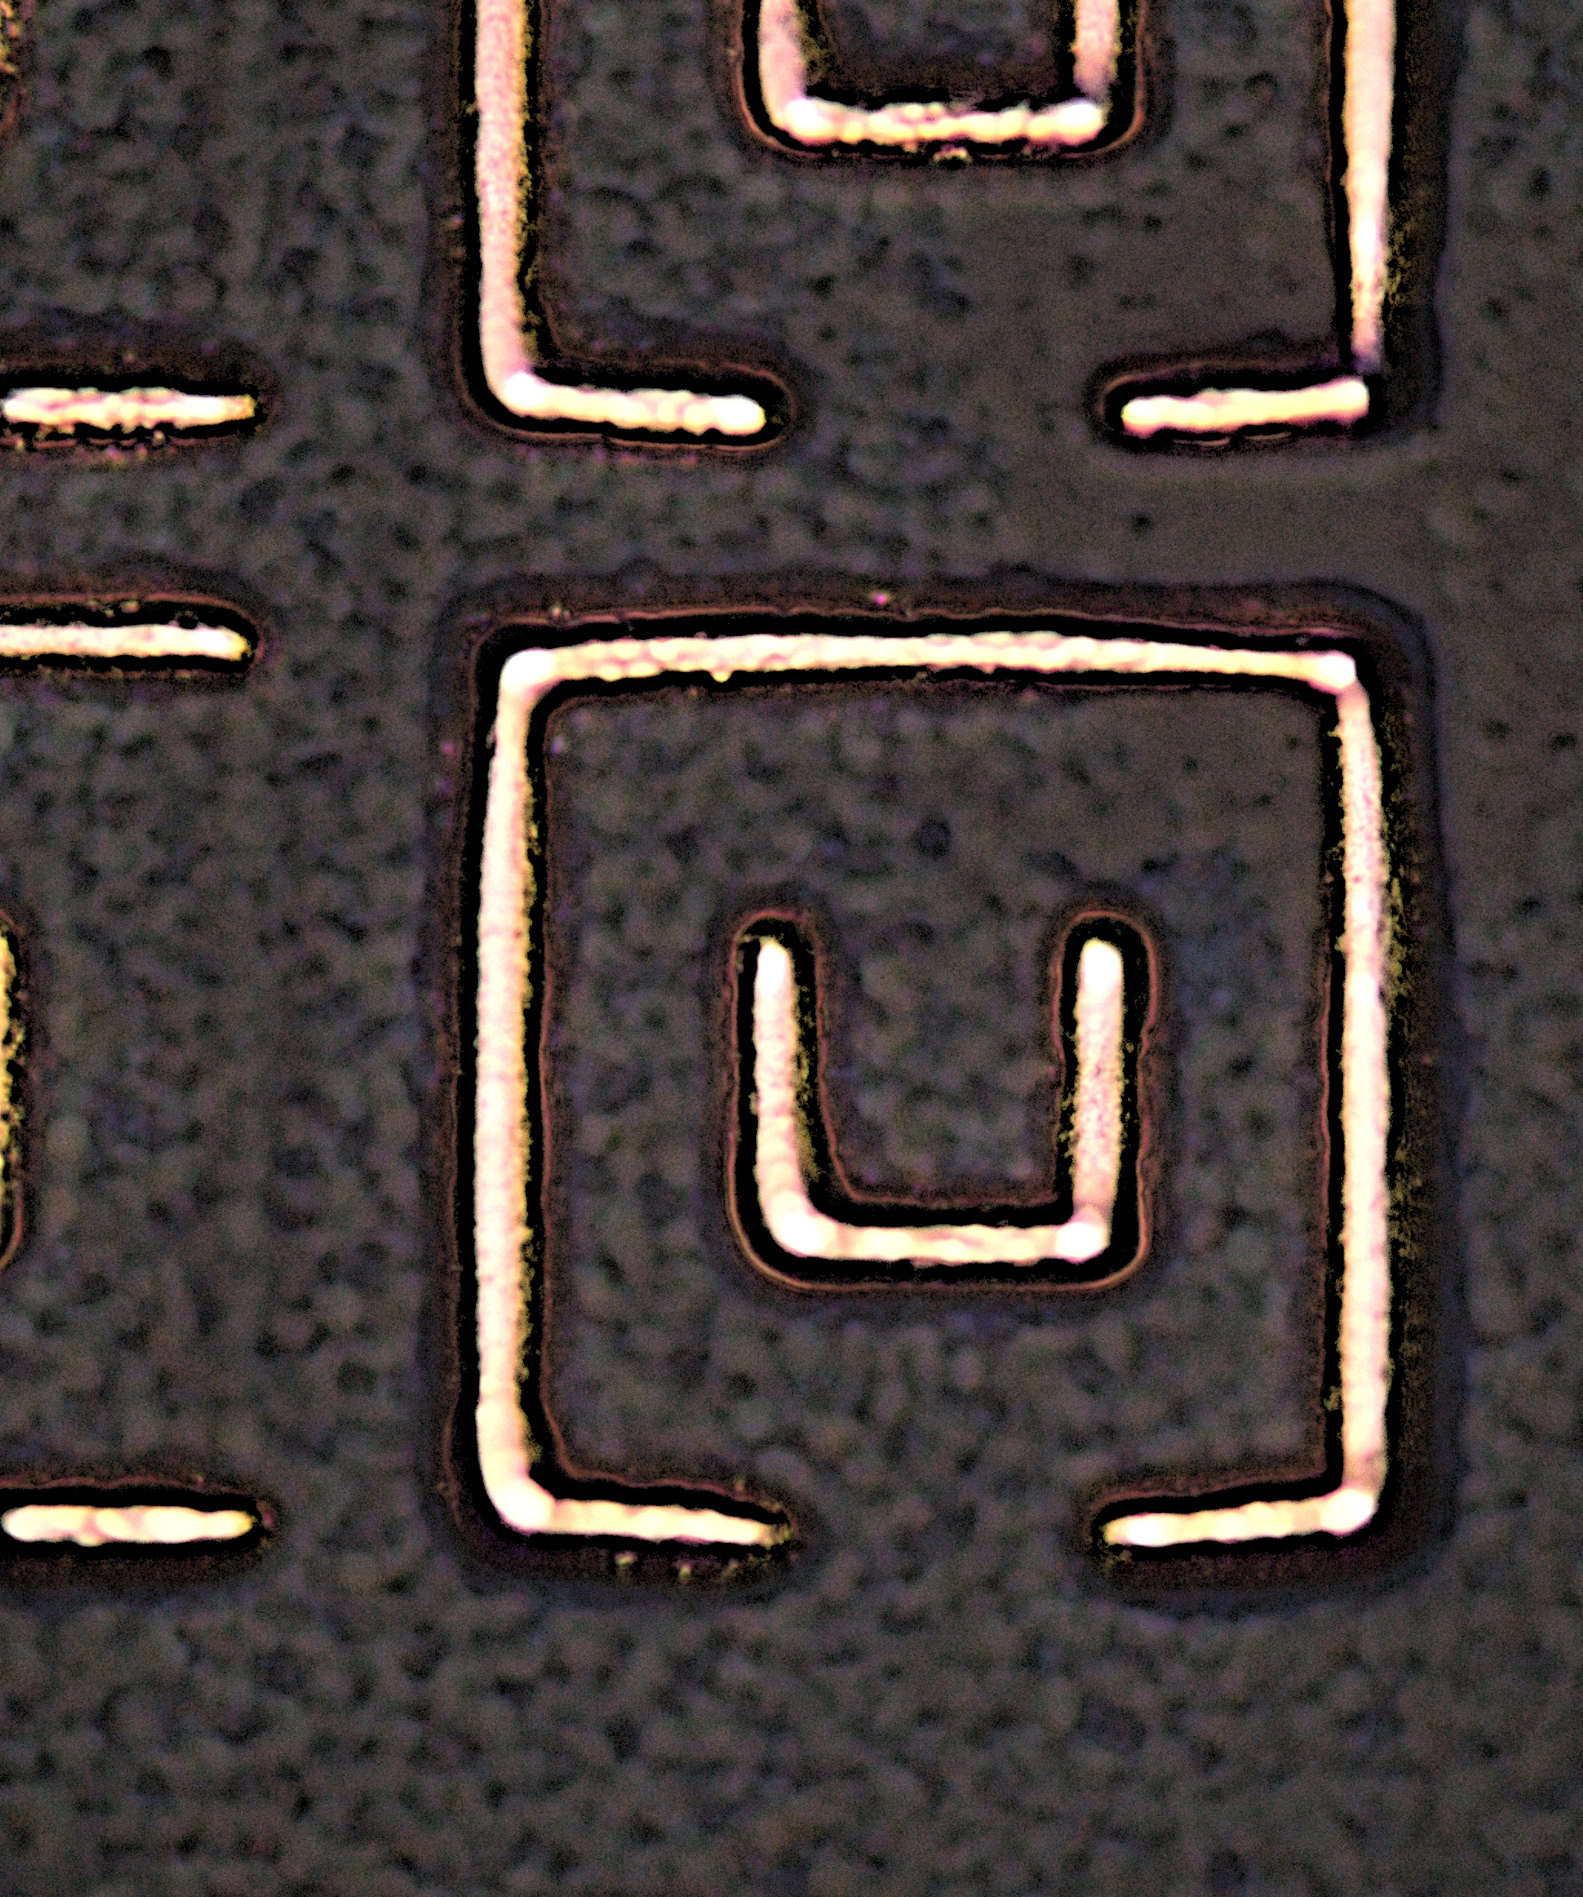
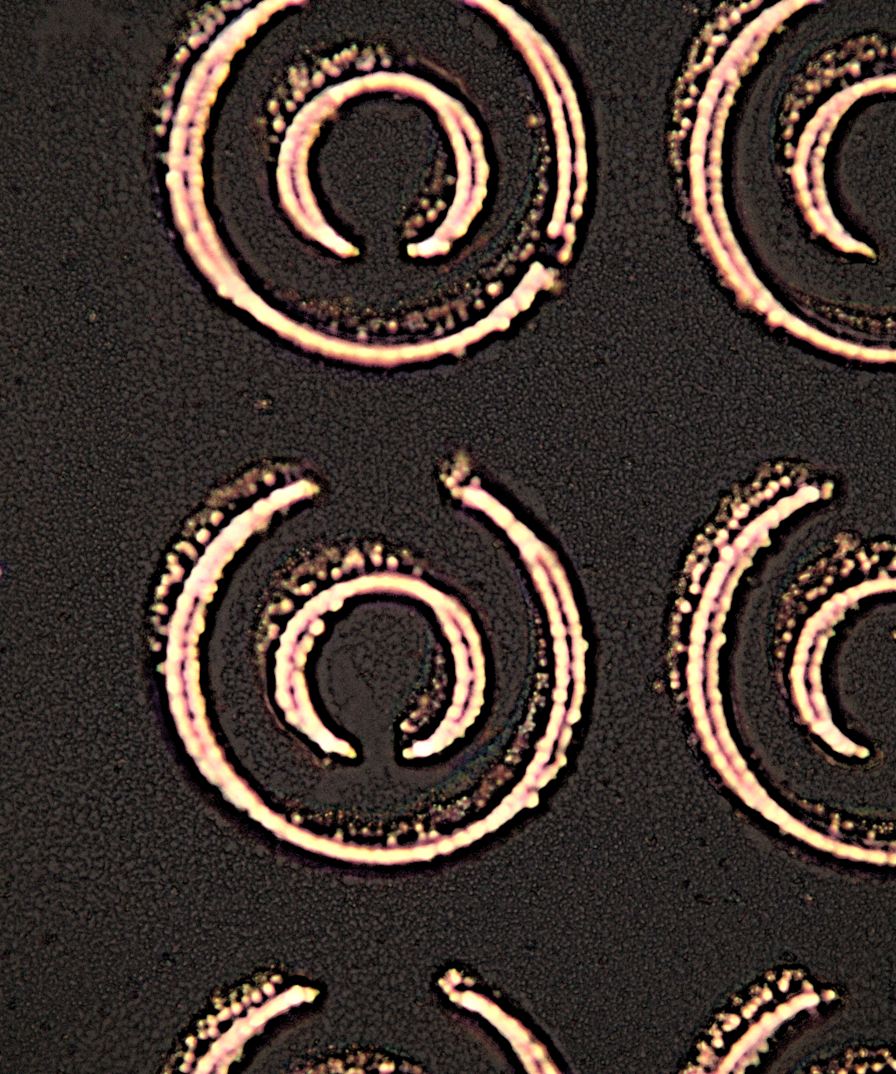
Selective metallization – Sub 5 µm
Requirement: Sub 5 µm selective metallization
Solution: CBM process and activated (design) with UV-laser
Case
CBM chemistry applied on whole surface and lines defined (activated) by laser.
Line width limited primarily by equipment used to define lines. Target is 1 µm lines.
Laser line definition process currently only implemented in lab environment.
Courtesy of Prof. Delsing,
Luleå University of Technology.
Double square SRR with strip line 3µm after copper metallization.
Double circular SRR with strip line 3µm after copper metallization.

Slide 35
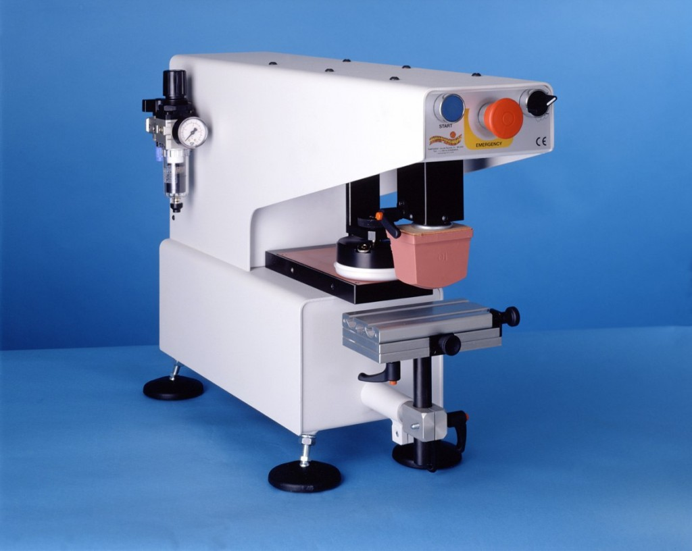
Selective metallization – 3D MID (LDS)
Requirement: Selective metallization on 3D parts
Solution: Apply CBM chemicals via Pad-printing
Case
Method: Pad printing
Alternative to LPKF’s laser activation.
Applies CBM chemistry where needed and then activates it with UV flood light.
Advantages
Lower capital expenditure
Less complex machines
Off the shelf machines
High productivity
Good results on PTFE (25µm lines)
Pad printing machine

Slide 36
Board members and key shareholders
Urban Fagerstedt | Chairman of the Board. Former VP R&D for Huawei Technologies Sweden and Senior Advisor to Huawei China. Urban has worked in the telecom industry 30 years. The last 15 years in development of cellular systems and in General Management positions for the last ten years.
Bo Westerberg | Board Member. Nötudden AB, Former VP at Ericsson, General Manager - Indelec (Spain), Plant Manager Philips, Senior Management Consultant - Maynard MEC AB and several Directorships.
Göran Lindahl | Former President and Chief Executive Officer at ABB, Ltd., Zurich, Switzerland, Currently member of the board of (among others) iGate Corporation (US), Patni Computer Systems Limited (India), Avinode Holding AB, LivSafe AB and IIT Board of Trustees (US, Chicago) - Previously member of the board of (among others) ABB, Anglo American, DuPont, Ericsson, Sony, Sony Ericsson, Ratos, Saab and, INGKA Holding BV (IKEA).
Hans-Göran Stennert | Board Member. IKEA Group, director of INGKA Holding BV (holding company for the IKEA Group) from 1993-2007. Chairman of the Board of INGKA Holding BV for the last ten years. Currently Chairman of the board of Eolus Vind AB.
Peter Sjöbeck | Board Member. CEO Cuptronic Technology AB,
Mikael Lövgren | Chairman of Bridgepoint's (private equity group) business in the Nordic regions. Prior to joining Bridgepoint in 2006, he spent twenty years with the Boston Consulting Group, as the founder and leader of its Nordic Operations and Nordic Healthcare Practice group. Mikael Lövgren currently sits on, among others, the board of the Karolinska University Hospital - a leading European hospital.
Notes:
The company is owned by interesting private individuals.

Slide 37
END

Slide 38
EXTRA SLIDES

Slide 39
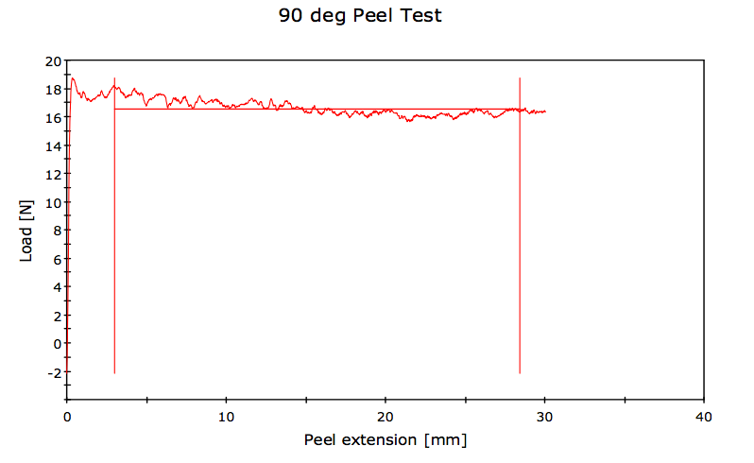
Adhesion test example
Material: PA6 (Minlon 73M40), 25 µm Cu strip
Pull rate: 25.00 mm/min
Strip Width: 6.35 mm
Surface: Rz = 0,15 µm
Peel Test According to IPC 650 Standard
Average Load/Width at average value (100 peaks and troughs) 26.1 N/cm
Average Load at average value (100 peaks and troughs) 16.6 N

Slide 40

CBM® visualized
Conventional processes
Galvanic plating to desired level
0,3-0,7 μm Electroless Cu or Ni
Activation and reduction of Pd
CBM process
Polymer structure build-up
Bare substrate

Slide 41
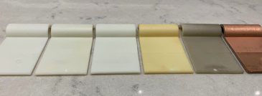
Surface at the process steps
1
2
3
4
5
6
Bare substrate
CBM process application chemistry and exposure
Wash (water)
Palladium activation
Palladium reduction
Electroless copper

Slide 42
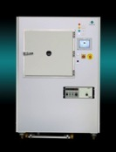
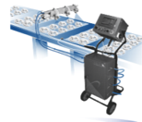
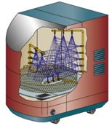
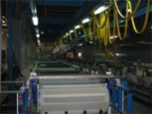

Next Generation 3D – Full Additive 3D Process
3D Design freedom for other plastic materials
(same 3D as LDS, but greater material choice)
Any number of antennas in the cover without significant cost increase
Plastic molding
Standard plastic
material incl.
glass fiber fillers
Surface
Treatment
(if necessary)
Apply CBM
Chemistry
Activate
selected
areas with
laser
Wash off
surplus
chemistry
E’less CU
process

Slide 43
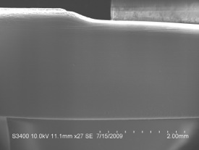
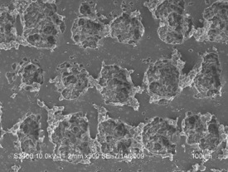
LPKF’s LDS method (Not Cuptronic’c CBM process)
Molding
Laser Structuring
Plating
Before Activation
After Activation
500x
LPKF =
Mechanical adhesion

Slide 44
Comparison Cuptronic vs LPKF
The Cuptronic process is different from the LPKF’s LDS process as no materiel is mixed into the plastic and that the laser is only used to activate the chemistry and not to ablate the surface.
These two differences will give the following advantages:
  Approx. 50% cost reduction of the plastic carrier compared to LDS material,
  No reduction in mechanical properties of plastic carrier (no limit on fillers)
  “No” color limitation
  Faster cycle times as a broader laser spot can be used and no z-axis correction is needed.
  Larger working volume without any need for Z-axis correction. Lower cost for laser optics.
  Much lower capital investments

