Slide 1
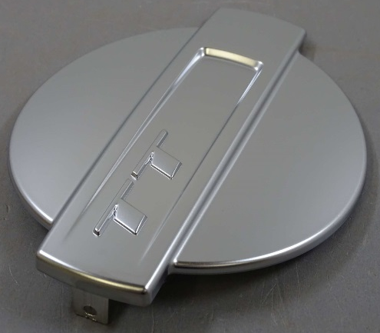
The CBM Process for POP
Better bonds between metal and plastic.
Peter Sjöbeck, CEO
peter.sjobeck@cuptronic.com
Mobile: +46 - 70 730 0000
Dr. Björn Atthoff, CTO
bjorn.atthoff@cuptronic.com
Mobile: +46 - 70 996 6118
Non confidential

Slide 2
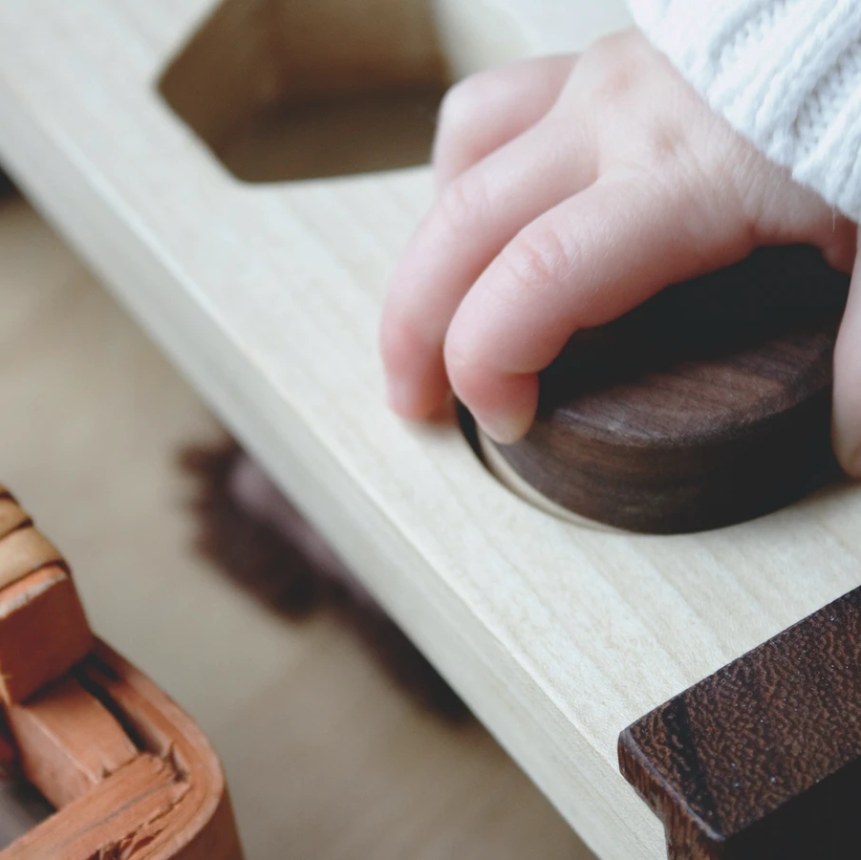

Our unique solution
A new chemical process, an adhesion promotion,
for attaching metal on non-metallic materials
Easy to implement
Enhances performance
Notes:
The CBM process (Covalent Bonded Metallization) is a revolutionary new way of attaching metals like Copper, Nickel, Silver and Gold to a variety of surfaces.
It is easy to implement, and enhances performance.
Today’s technologies for metal-adhesion to non-metallic surfaces rely mainly on mechanical adhesion by first creating a rough surface (down into the surface).
Current technologies have several issues, three of which being choice of materials, production cost and the use of Chrome+6 for etching.
The CBM process solves there problems.

Slide 3
Covalent Bonded Metallization
The CBM© Process
1
2
3
4
Spray/dip
CBM chemicals
Expose to
UV light
Activated surface structures
Apply Palladium and electroless
Cu or Ni
Notes:
The CBM process is very simple.
You apply the CBM chemical by spray or dip, and thereafter you expose it to UV light.
That is it.
Before you continue to standard Electroless Cu or Ni, you wash the pieces with cold water.

Slide 4
CBM Process, Adhesion promotion on smooth surface
CBM process
18 microns electroplated Cu
≈ 50 nanometer CBM Process
+ 0,2 microns electroless Cu or Ni
Notes:
Here in between the ABS and the elctroless Cu we have applied our process and created a bond which is approximate 100 nanometers.
On this bond we have applied standard 0,2 microns of Ni or Cu, and thereafter electroplated 18 µm of Cu

Slide 5
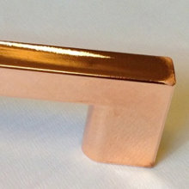
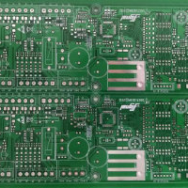
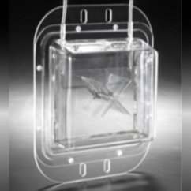
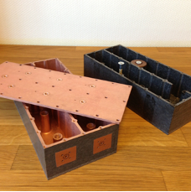
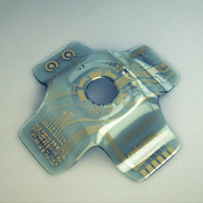

CBM solves problems in many areas
Plating on Plastic
Allows for metallization on a wide variety of plastics in a multitude of shapes. No Cr(VI)
EMP/EMI shielding
Allows metalization on materials ranging from micrometer thick foils up to large 3D structures
PCB properties
Allows the production of very advanced circuit boards, high frequency, advanced patterns, narrow lines and spaces.
New materials
Allows for metalization of a multitude of plastics
Replace metal to plastic
Allows the reduction of weight by replacing metals to plastics
Selective 3D metallization
No ablation, new materials

Slide 6
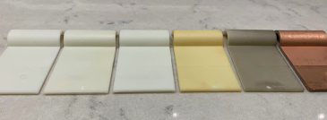
Surface at the process steps
1
2
3
4
5
6
Bare substrate
CBM process application chemistry and exposure
Wash (water)
Palladium activation
Palladium reduction
Electroless copper

Slide 7
Evaluated POP materials. (several non-plating grade)
Plastic | Product name | N/cm | Lbs/in
PC/ABS | Cycoloy C1200 | 9 | 5.1
PC |  | 1 | 0.6
ABS | Novodur P2MC HI 121 H Recycled ABS: 50% LG TR558AI & 50% TERLURAN HI10 | 15 14 12 | 8.6 8.0 6.8
PLA filled with hemp | Trifilon Switch | 10 | 5.7
ASA |  | 13 | 7.4
PP |  | 30 | 17.1
PA 6 | Minlon 73M40 NC Grilon BS Natural Promyde B30 NC 100 Badamide B70GF30 | 40 40 20 20 | 22.8 22.8 11.4 11.4
PA 6,6 | Leona 91G60 | 15 | 8.6
PA 12 | Grilamid LV65H | 20 | 11.4
TR90 (PA) |  | 40 | 22.8
TPE |  | 20 | 11.4
PEI | Ultem 3452 | 8 | 4.6
Peel Strength according to IPC-650 and ASTM standard (1 oz Cu)
Notes:
These are a few of the materials we have tested for different customers.
The list increases for every month.

Slide 8
Evaluated PCB materials
Plastic | Product name | N/cm | Lbs/in
Certain epoxy (HFFR4) |  | 15 | 8.6
PTFE | Taconic TLP 5 Taconic TLX 9 Nelco N9000 Rogers 3003 Rogers CLTE-MW | 25 >50 20 25 20 | 14.3 >28 11.4 14.3 11.4
LCP | Rogers Ultralam 3850 | 10 | 5.7
PI |  | 15 | 8.6
COC (Cyclic Olefin Copolymer) |  | 15 | 8.6
Peel Strength according to IPC-TM-650 2.4.8 (1 oz Cu), after solder float

Slide 9
CBM Process features
“Simple” - Apply chemistry and UV light
CBM chemistry - Low cost
Applicable on a variety of new materials
Able to metallize very thin, and smooth substrates
High adhesion
Can be installed as parallel line, or other location

Slide 10
Process benefits for POP
Wide variety of plastics can be plated
  Non plating-grade materials (properties & cost reduction)
  Recycled ABS
Plateability doesn’t restrict choice of functional materials
Increased injection molding yield
Potentially replace Pd with Silver as catalyst
Cr(VI) free, a non-etching process

Slide 11
Plating On Plastic

Slide 12
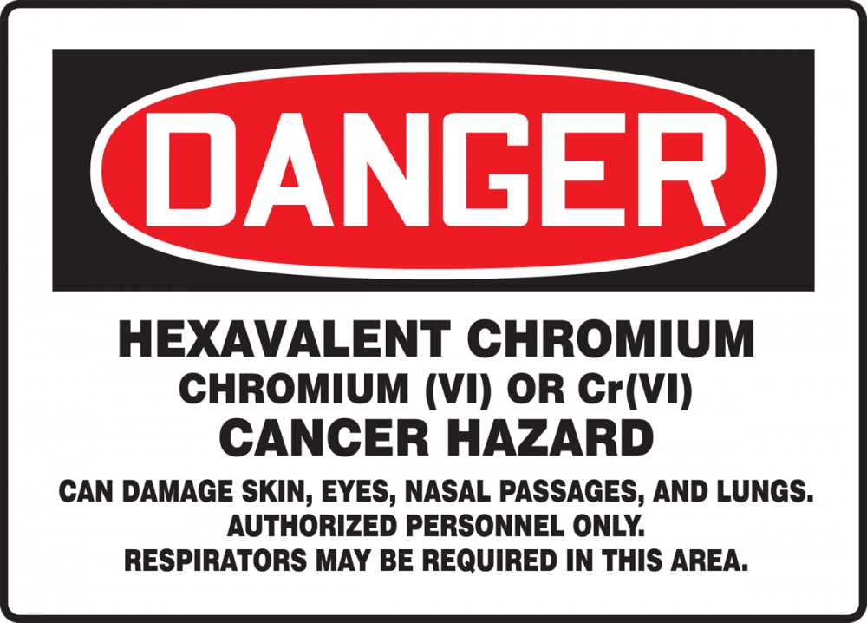
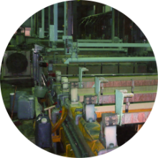
POP problem 1: Health and environment
The CBM® Process chemically alters the surface to enable electroless metal deposition. No etching, no Cr(VI).
Metal adhesion technologies today are mainly mechanical and rely on etching to achieve a structured surface.

Slide 13
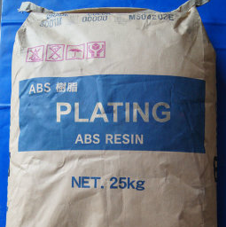
POP problem 2: Limited choice of plastics
Only specific ”plateable” plasting-grade plastic
can be used in conventional POP processes.
Notes:
With the CBM process you can metallize many new different plastics in the same production line.
You can metallize for instance ABS, PC/ABS and PA6 in the same production line.
You can also use non-plating grade plastics, which are less expensive than plating grade.

Slide 14
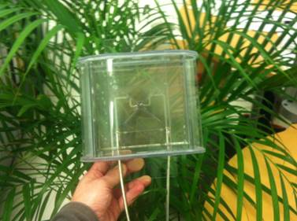

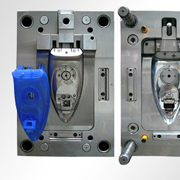
Plastics can be chosen for their properties
Color or transparency
Weight or strength
Molding characteristics
The CBM Process allows a much wider choice of plastic,
as well as fewer shape and molding restrictions.

Slide 15
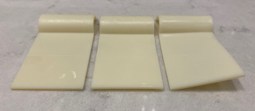
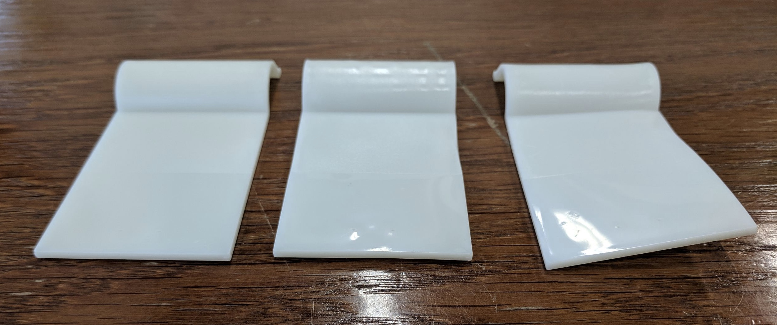
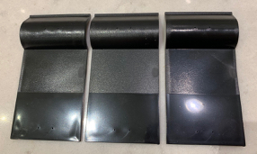
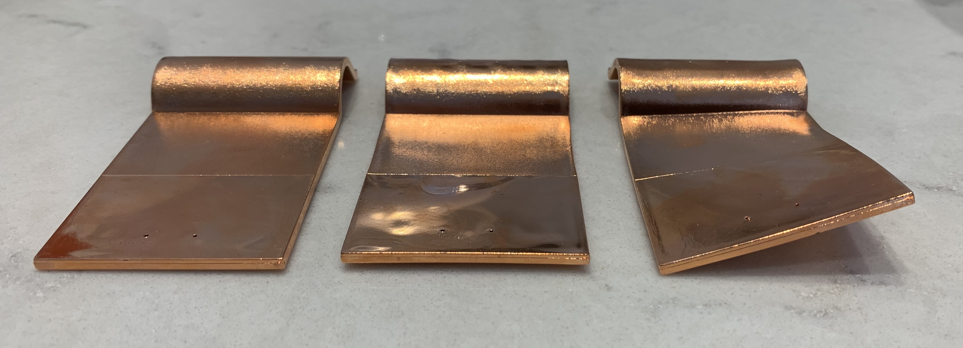
Different injection molding parameters
1: Normal / 2: No after pressure / 3: Short cooldown time
1
2
3
1
2
3
1
2
3
ABS Novodur P2MC Natur
Plating grade
LG HI121H
Non-plating grade
PC/ABS Cycoloy C1200
Non-plating grade
1
2
3
Same good adhesion using different parameters
Notes:
The CBM process is less sensitive for the quality of molded parts.
We have tried three different bad molded parts with excellent results. No affect on adhesion.

Slide 16
CBM – in a POP Process
Pre-wash (if necessary)
Drying (if necessary)
Application of Cuptronic Chemistry (spray, dip, roll, conveyor)
Curing of Cuptronic Chemistry (UV light conveyor)
Washing (cold water)
Activation with, and Reduction of Pd
Electroless Cu or Ni deposit
Continue normal process
RED = new for a POP manufacturer

Slide 17
CBM – in a POP Process
Pre-wash (if necessary)
Drying (if necessary)
Application of Cuptronic Chemistry (spray, dip, roll, conveyor)
Curing of Cuptronic Chemistry (UV light conveyor)
Washing (cold water)
Activation with, and Reduction of Pd
Electroless Cu or Ni deposit
Continue normal process
If next to a
molding machine
Start here ➔
RED = new for a POP manufacturer
Notes:
The most elegant solution is to insert our process directly at the molding equipment.
Here you already have the parts in a robot arm and the robot arm can be used to apply our process.
Our process needs approximately 15 seconds for spray and exposure of UV light.

Slide 18
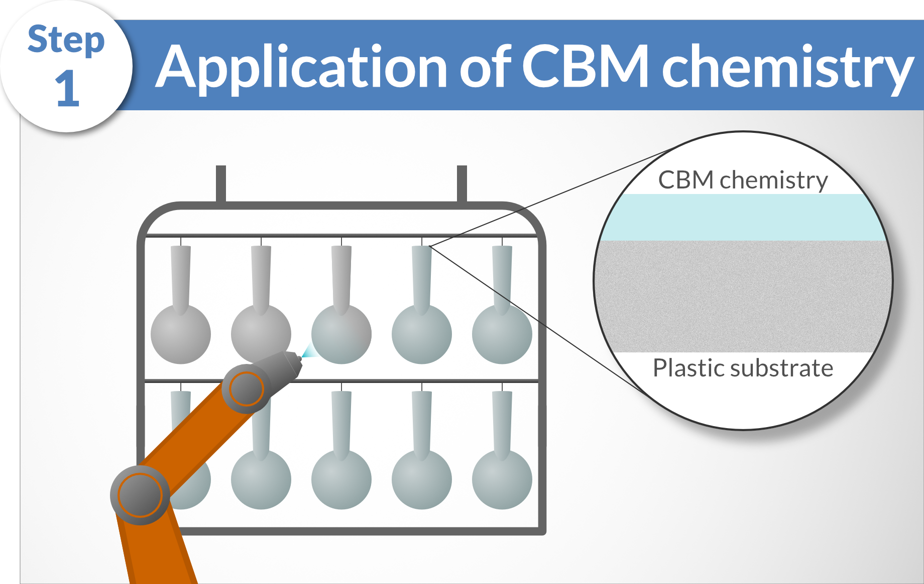
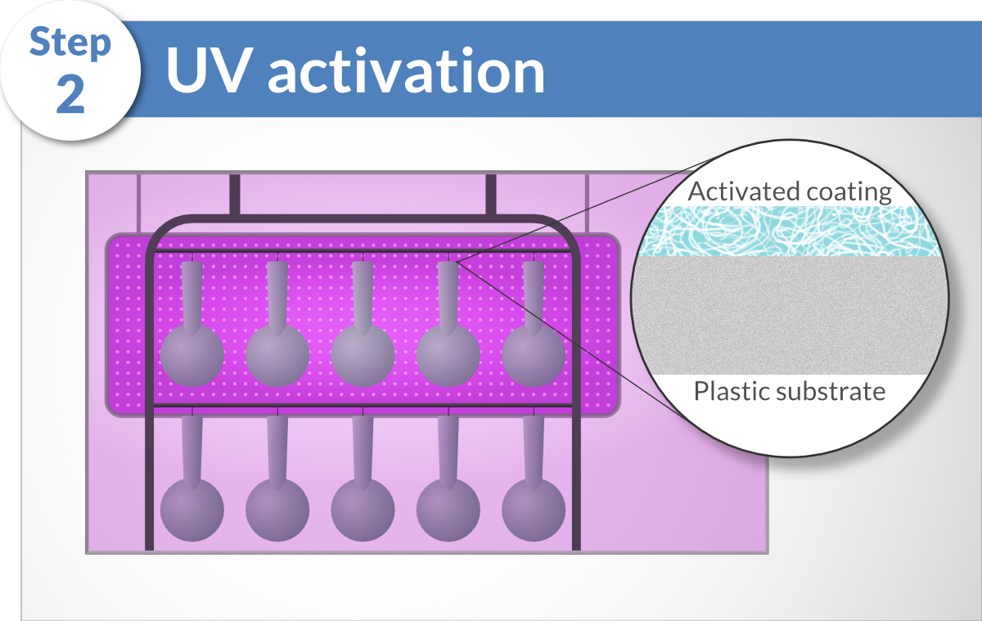
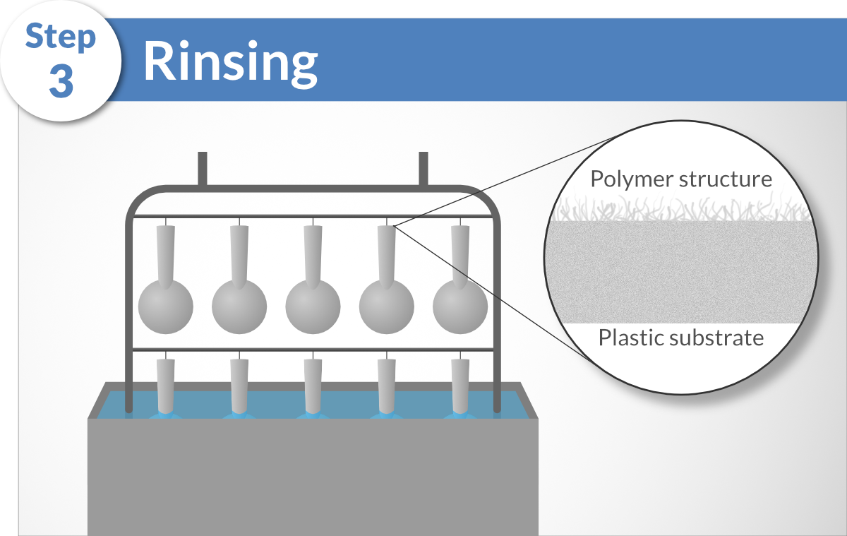
The CBM Process
Surface cleaning and preparation (if necessary)
Conventional electroless Cu or Ni process
Notes:
This is an example having pieces on the racks that could be inserted in today’s production lines.

Slide 19
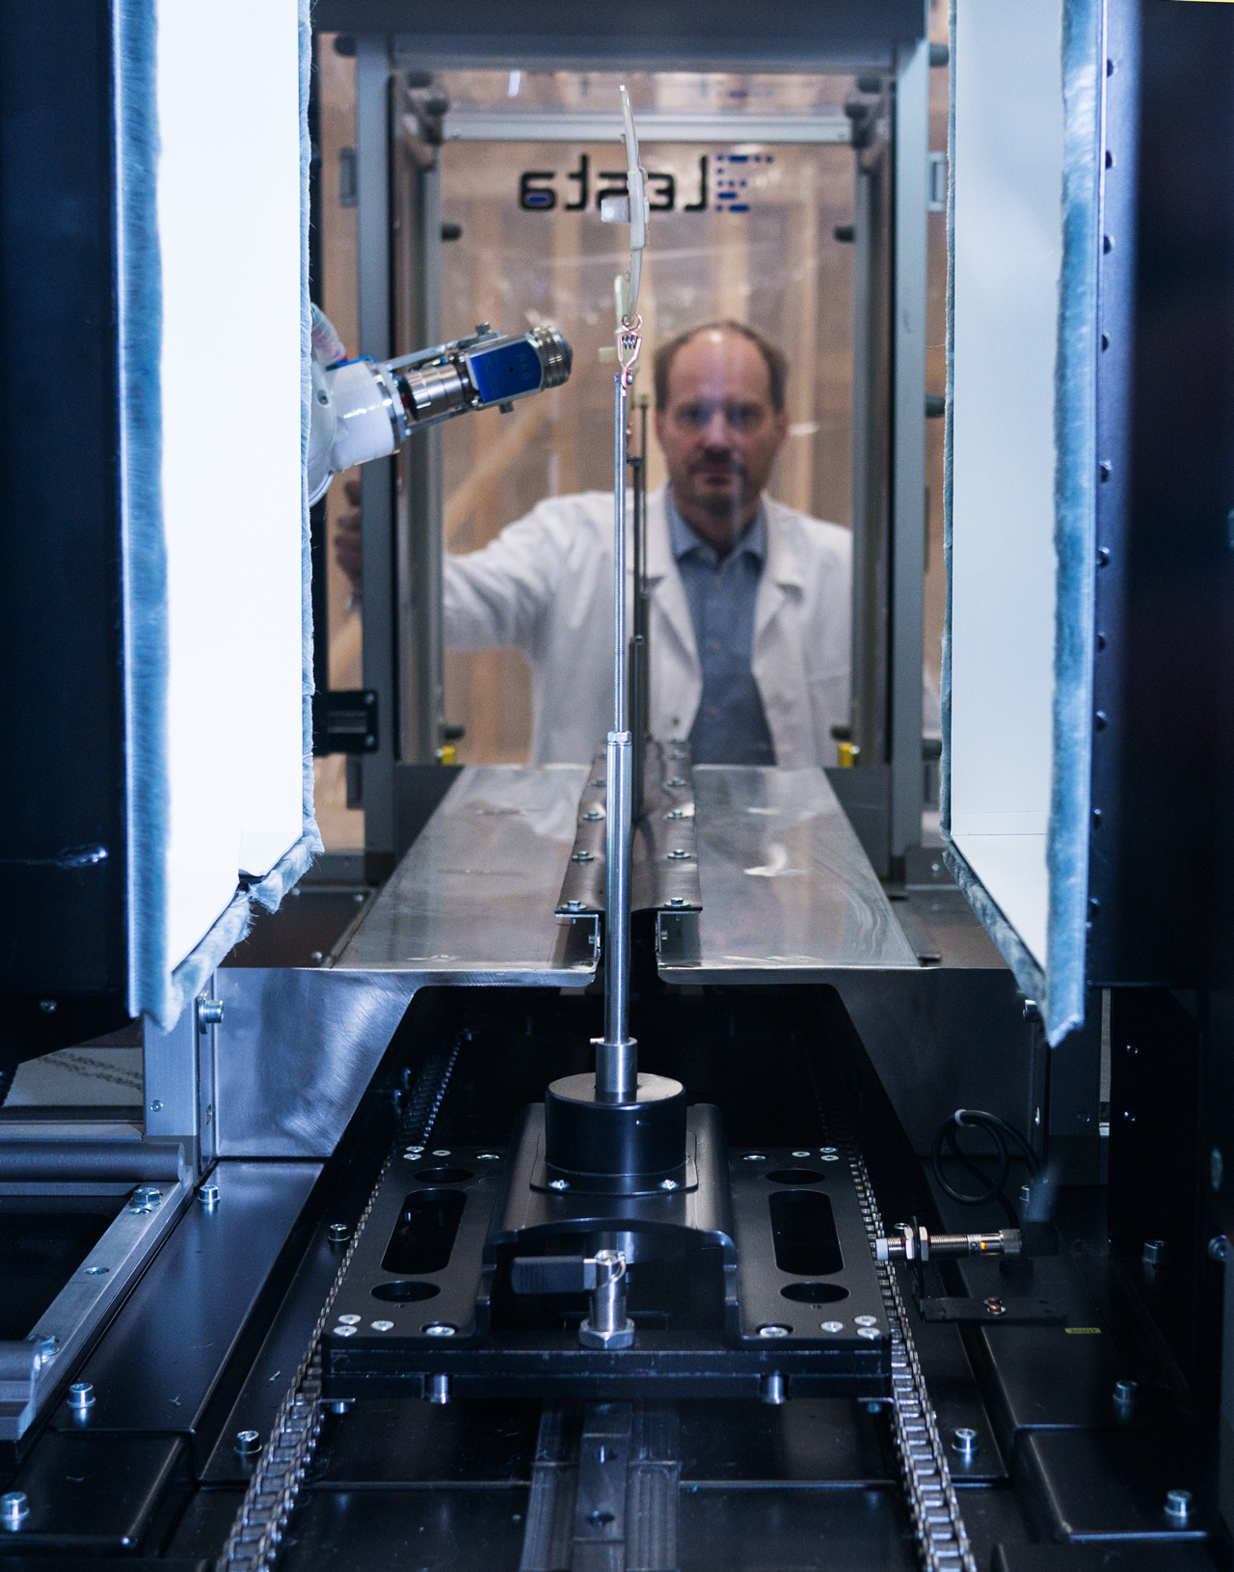
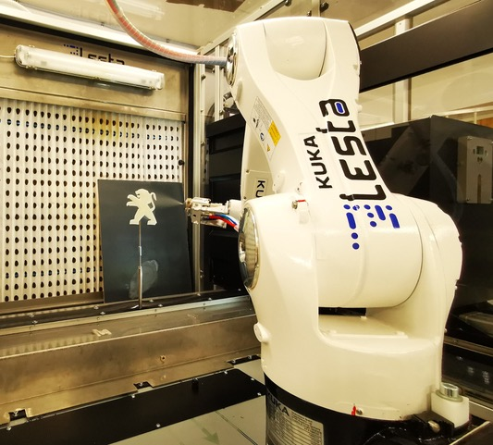
Prototype production unit for a Tier 1 supplier
Notes:
We have a fully automated CBM robot in Sweden to show that the process can be done completely hands-free.
Next is the film showing the robot line in action.

Slide 20
Place for robot film
(see separate file)

Slide 21
Some Projects
Notes:
I will now show four different projects utilising our CBM process

Slide 22
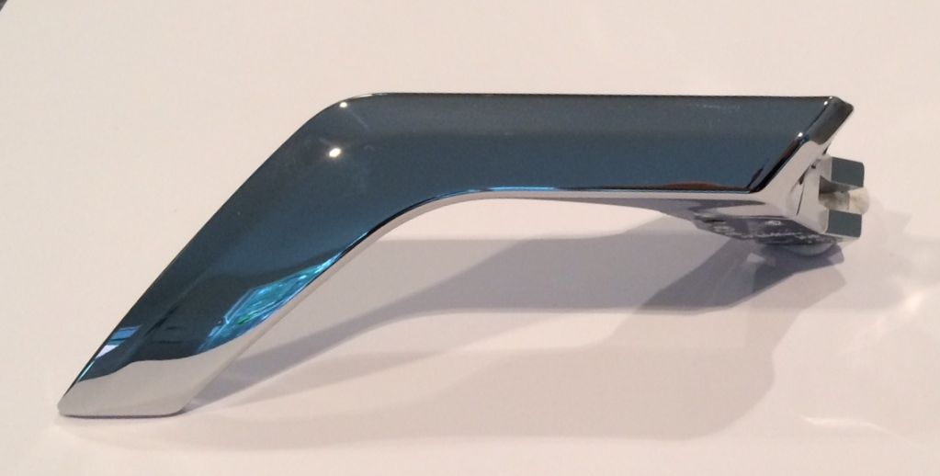
Car door handles (SKODA)
Requirement: Wear and tear resistant metallized plastic without Cr(VI) etching.
Solution: CBM Process applied to reinforced plastic.
Case
Minlon® 73M40 NC - 40% mineral reinforced PA6
No restriction on the type of fillers in the polymer, allows for better mechanical properties.

Slide 23
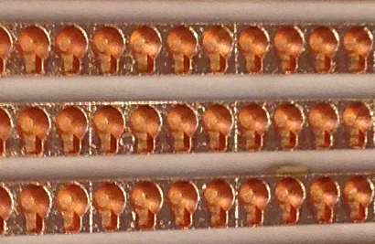
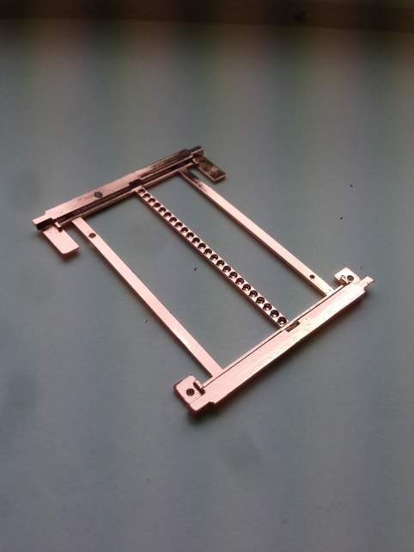
LED reflectors and touch screens
Requirement: Increase yield and lower production cost
Solution: CBM Process enables thinner reflectors and eliminates the need of 2K-molding
Case
No 2K-molding, thinner material, no etching = thinner metal layer.
Increase number of LED reflectors from 186 to 440 (+136%) in same production frame.
Notes:
Skoda wanted to try to use PA6 instead of PC/ABS on their car door handles because of the high forces on the handle.
They sent us six different PA6 (plating and non-plating grade) materials and all passed their internal tests.

Slide 24
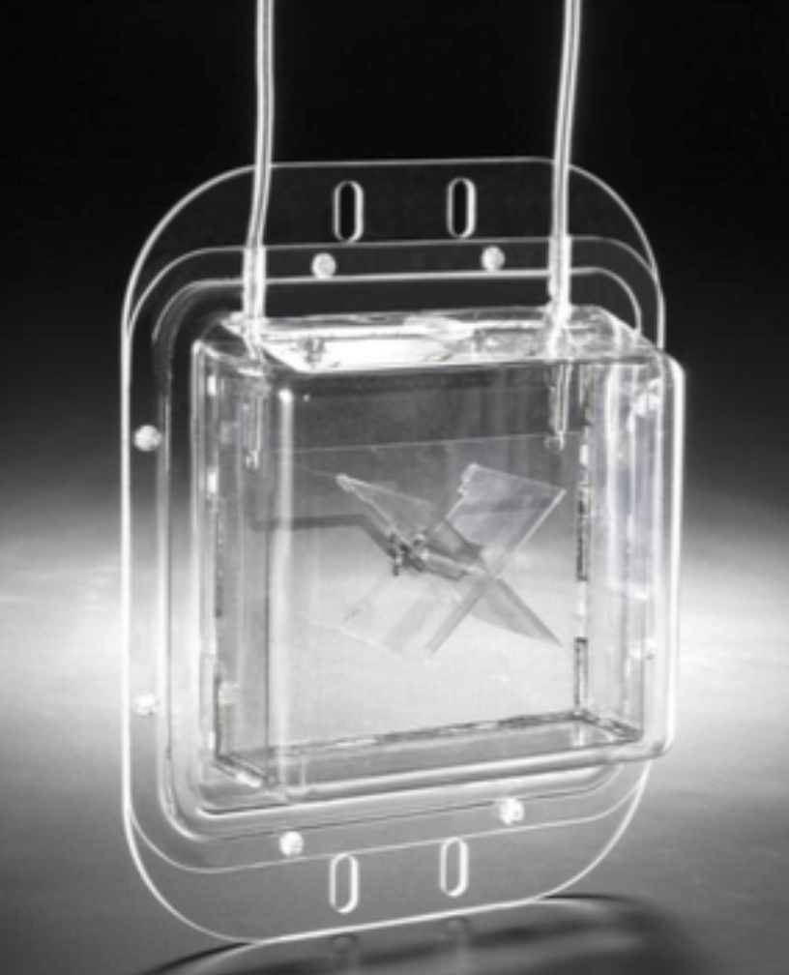
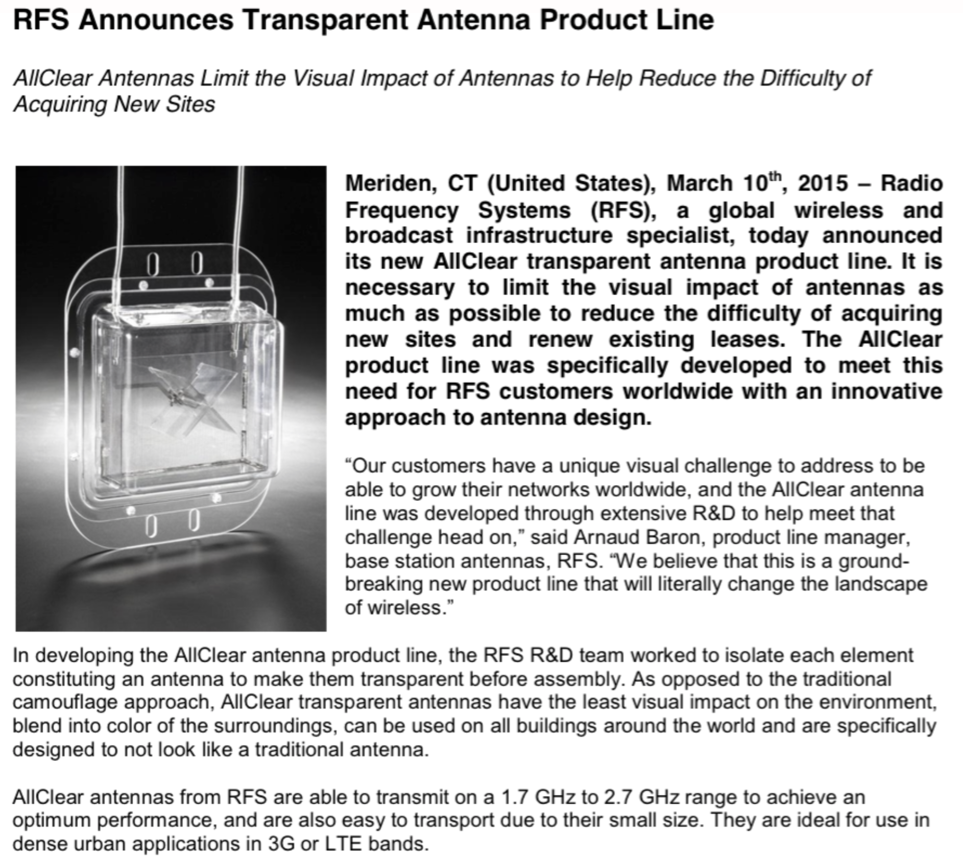
AllClear Antennas RFS (Alcatel-Lucent)
Problem: 85% of building owners say no to antennas due to unsightly visuals.
Solution: Transparent Antennas made from C.O.C. plastic.
Case
Notes:
RFS wanted to create a transparent antenna because 85% of the property owners in France did not want to continue to lease their properties to telecom companies for their mobile antennas because of visual pollution.
We help them find a transparent plastic which works very good with our CBM process.

Slide 25
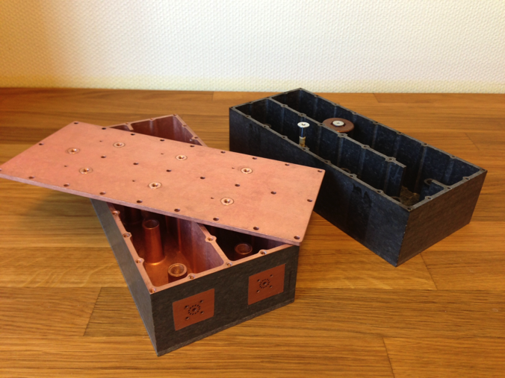
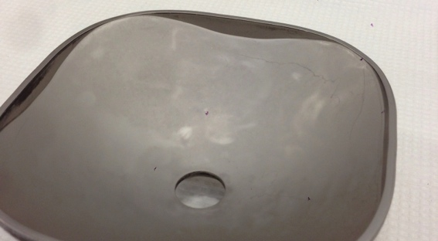
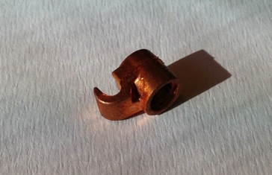
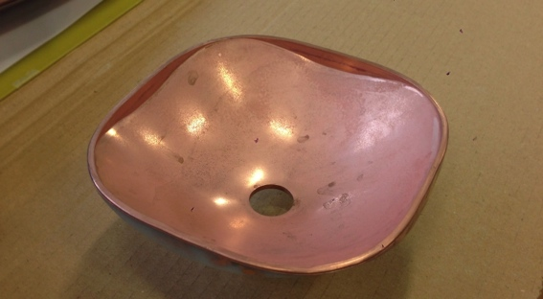
RFS/Alcatel, Lucent and others
Requirement: Reduce weight and decrease production cost.
Solution: Substitute metal components with metallized reinforced plastics.
Case
Telecom - Air cavity filters
From aluminum to metalized plastic
(GE ULTEM® 3452)
RFS/Alcatel’s connectors
From brass to metalized plastic
RFS/Alcatel’s antennas
From metal to metalized plastic
Notes:
Several companies want to use the CBM process to change their products from metal to plastic.
As we do not go down into the material the plastic can be very filled to increase properties.

Slide 26
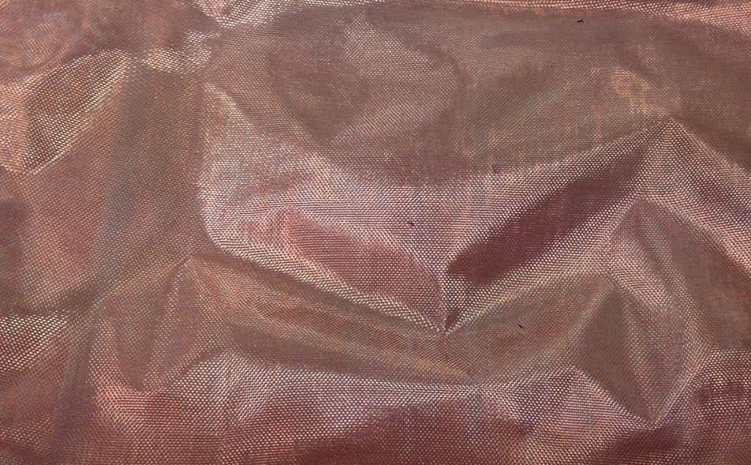
EMP/EMI Shielding (Samsung)
Problem: Thinner shielding materials.
Solution: Substitute textile EMI shielding (1 mm) with a metalized PET film (0.05 mm).
Case
1 mm textile with Copper
10 µm PET film with 2 x 20 µm Cu

Slide 27
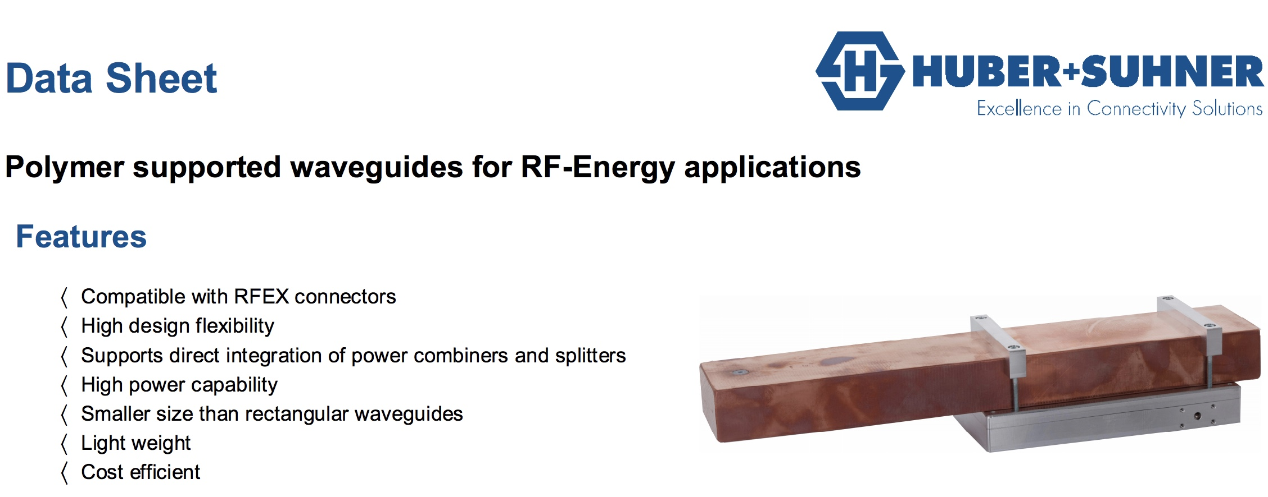
Plastic waveguides (Huber+Suhner)
Requirement: Reduce size, weight and cost of waveguides.
Solution: Metallized C.O.C plastic.
Case

Slide 28
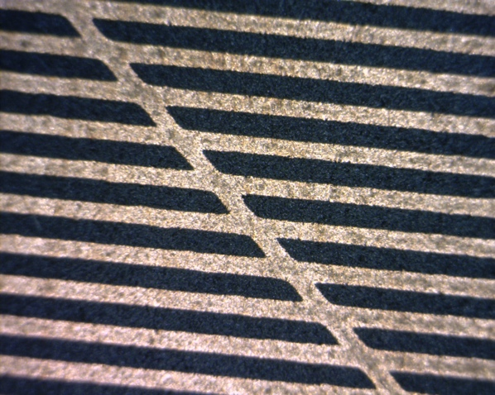
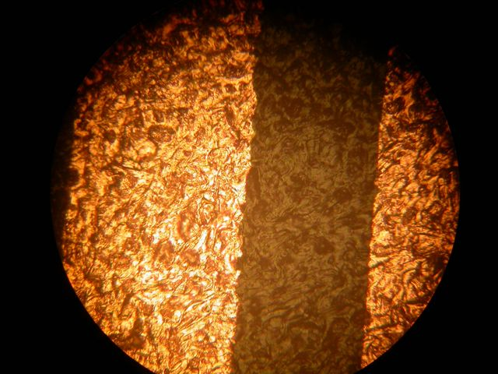
Selective metallization – 3D MID (LDS)
Requirement: Selective metallization on 3D parts
Solution: Either with UV-laser, Inkjet, or even better with Pad-printing.
Case
3 Methods
UV - Laser (apply CBM chemistry, design with laser)
Inkjet (apply design with Inkjet printer)
PAD printing (apply design with PAD printer)
Advantages
Cheaper materials with better properties can be used
Smooth surface under copper traces
Excellent edge definition
No creation of dust
E-less Copper lines on PA-6

Slide 29
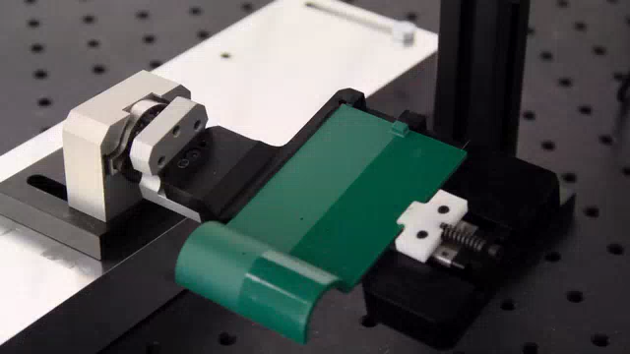
Selective metallization – 3D MID (LDS)
Requirement: Selective metallization on 3D parts
Solution: CBM process and activated (design) with UV-laser
Case
VIDEO

Slide 30
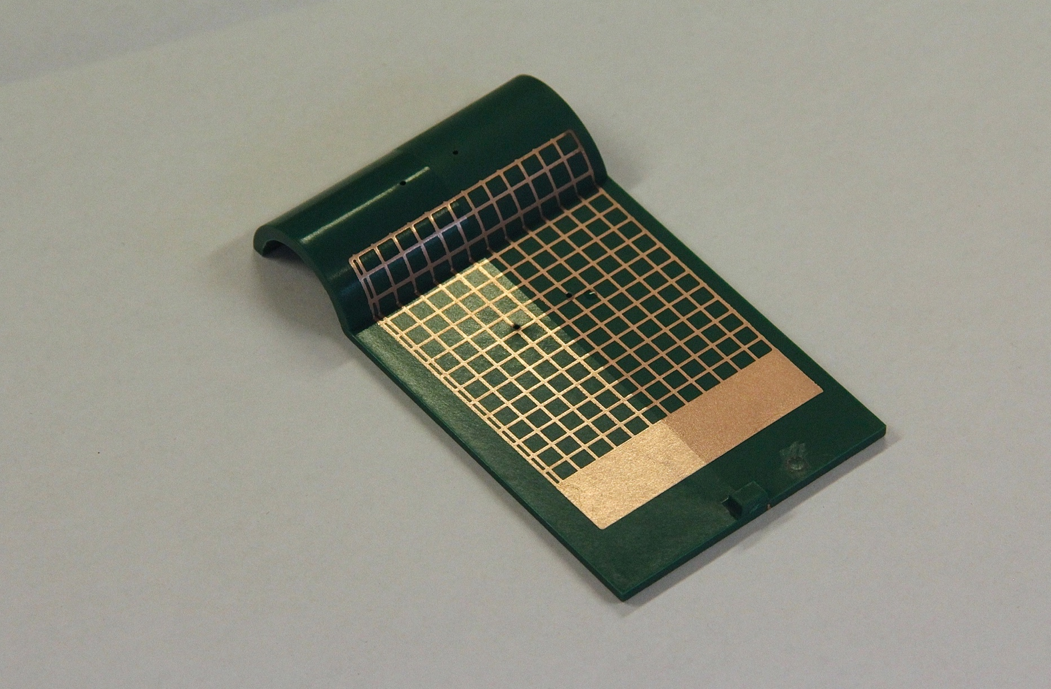
Selective metallization – 3D MID (LDS)
Requirement: Selective metallization on 3D parts
Solution: CBM process and activated (design) with UV-laser
Case
Result of previous
VIDEO

Slide 31
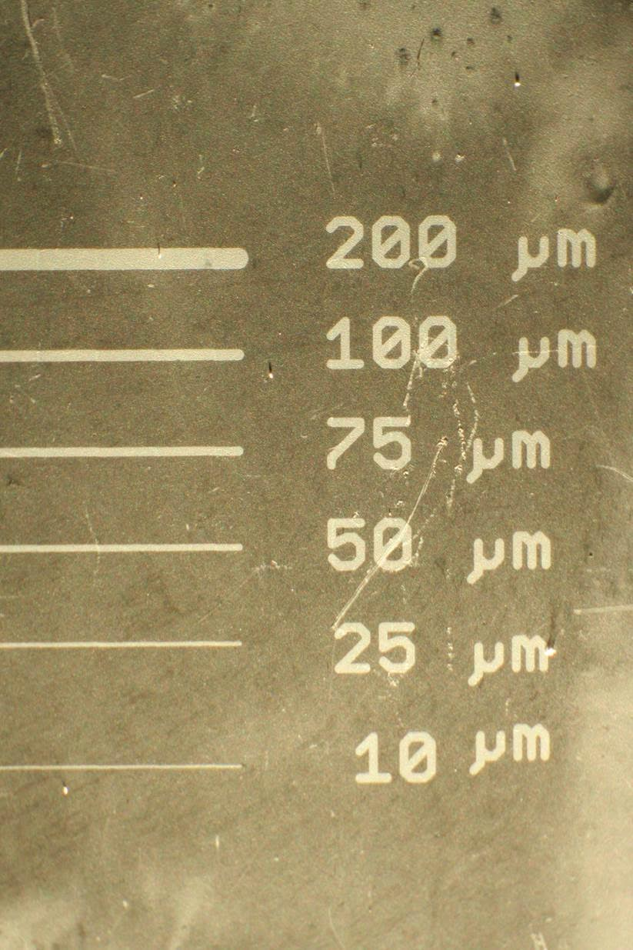
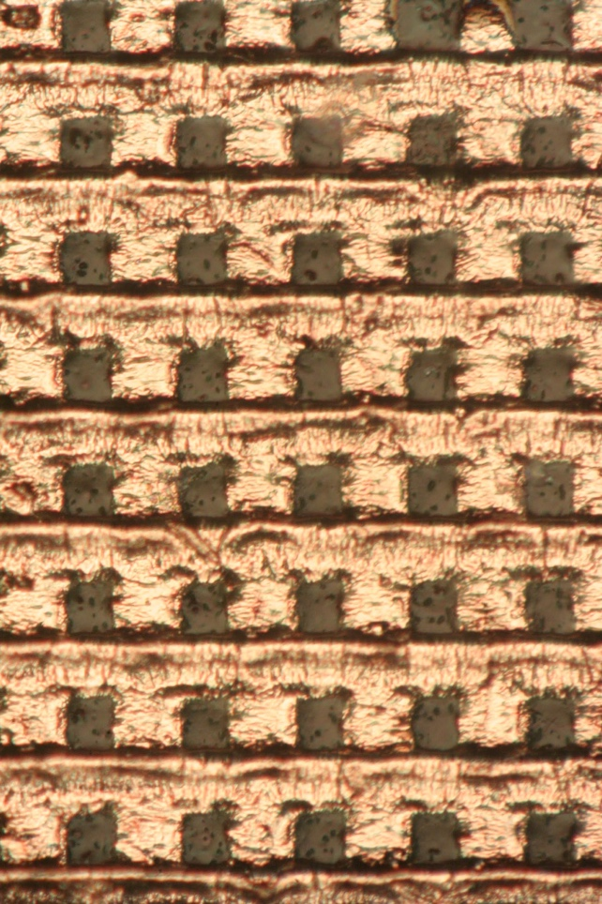
Selective metallization – 3D MID (LDS)
Requirement: Selective metallization on 3D parts
Solution: CBM process and activated (design) with UV-laser
Case
CBM chemistry applied on whole surface and lines defined (activated) by laser.
Line width limited primarily by equipment used to define lines. Target is 1 µm lines.
Laser line definition process currently only implemented in lab environment.
Courtesy of Prof. Delsing,
Luleå University of Technology.
Multiple line widths
7 µm lines

Slide 32
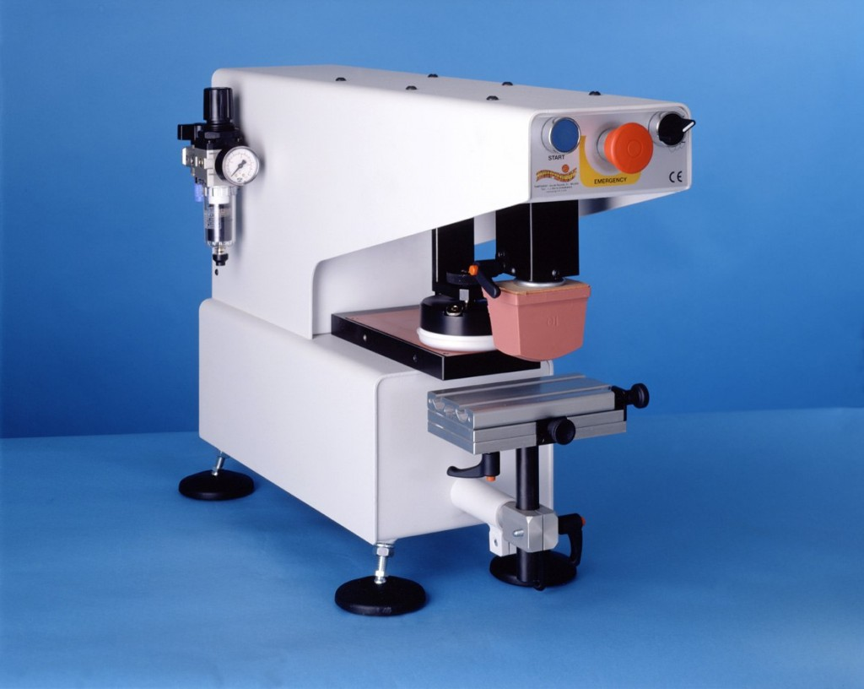
Selective metallization – 3D MID (LDS)
Requirement: Selective metallization on 3D parts
Solution: Apply CBM chemicals via Pad-printing
Case
Method: Pad printing
Alternative to LPKF’s laser system.
Applies CBM chemistry where needed and then activates it with UV flood light.
Advantages
Lower capital expenditure
Less complex machines
Off the shelf machines
High productivity
Good results on PTFE (25µm lines)
Pad printing machine

Slide 33
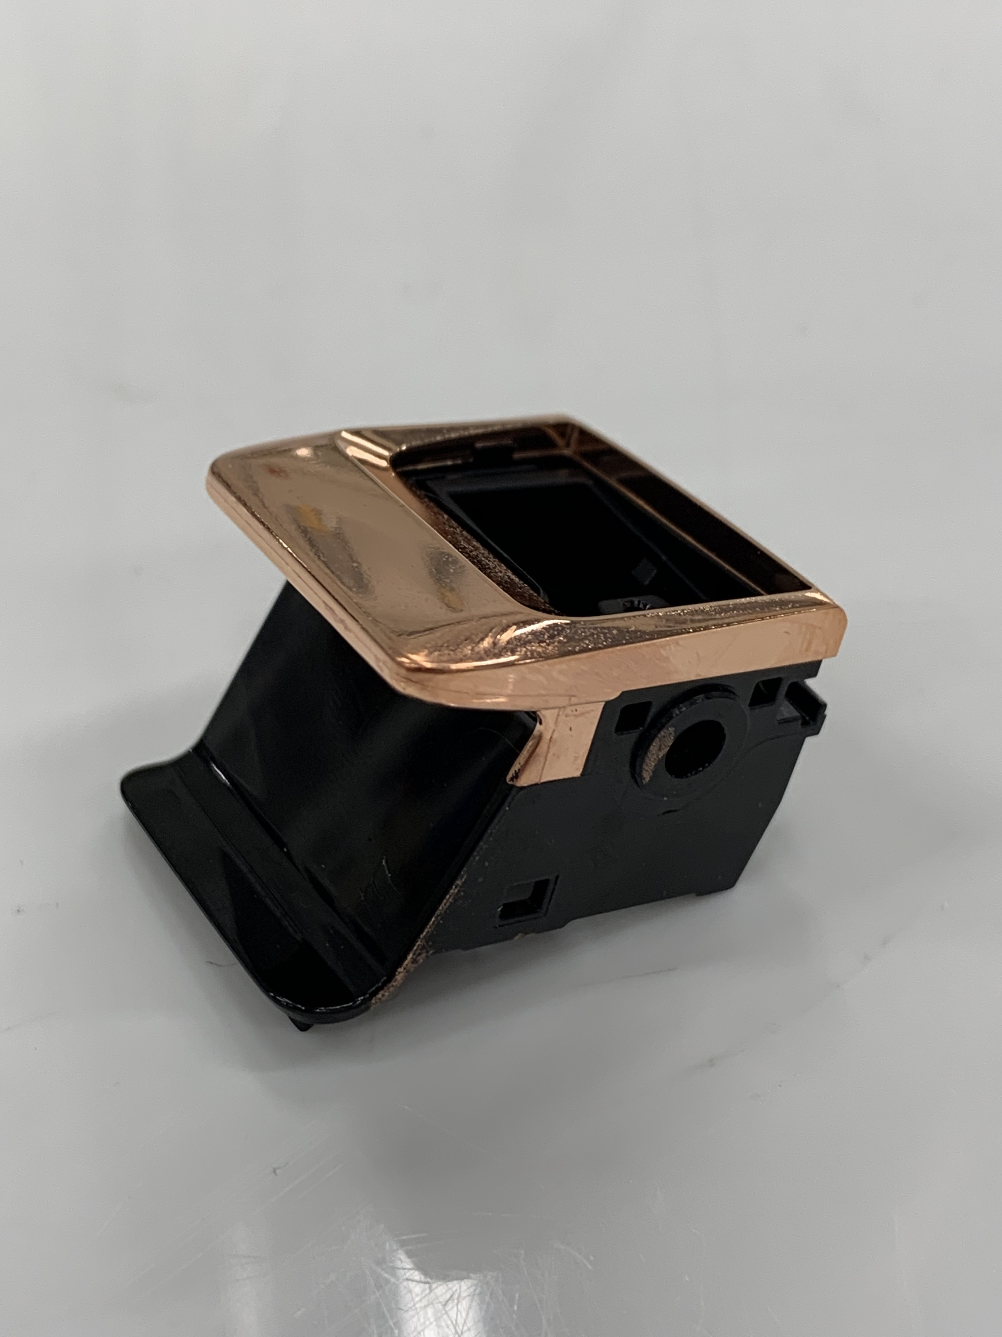
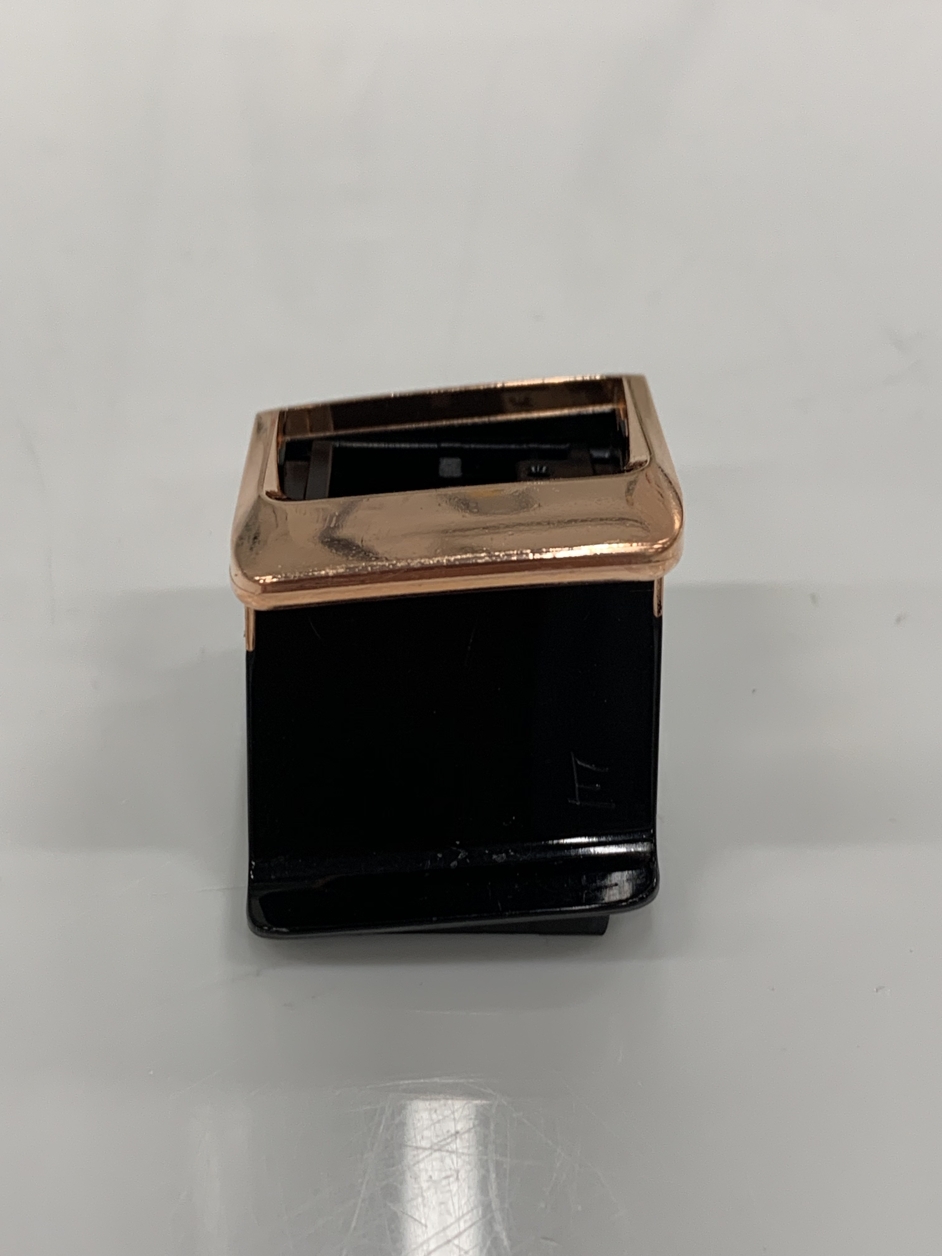
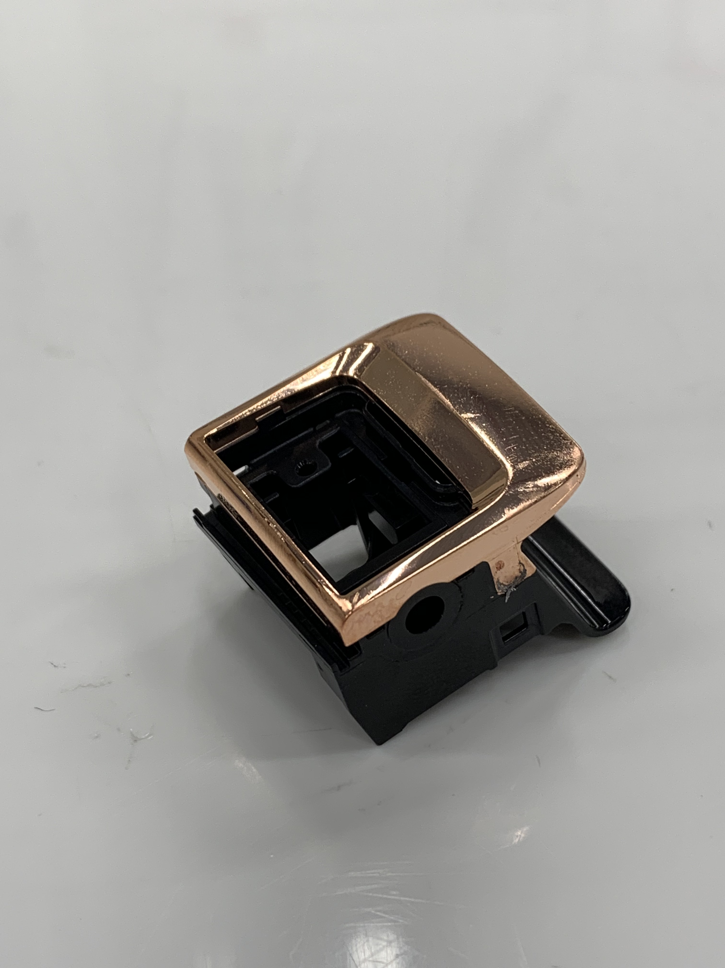
2K molding (under development)
e.g. Standard ABS + Filled ABS, doped to block/prevent CBM adhesion
Instead of PC/ABS and PC as above
Notes:
For 2K moulding we can insert a poison for our chemistry in one of the plastics so our process will not attach to it.
So you can 2K mold an ABS part with another very filled ABS part (for different properties)

Slide 34


Completely CR(VI) free POP
In cooperation with SurTec International GmbH

Slide 35
Process sequence for Cr(VI) free plating
Alternative solutions/basic principles for advanced plastic pretreatment
CBM Cr(VI) free pretreatment
Application of CBM chemistry
UV exposure
Electroless Ni or Cu
Immersion Copper
Acid Copper
Copper Activation
Semi-bright Nickel
Satin Nickel
Microporous Nickel
Trivalent Chromium
Predip
Ionic Palladium
Reduction
e.g. SurTec Cr(VI)
free top layer

Slide 36
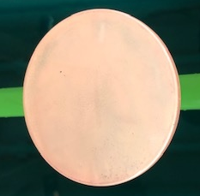
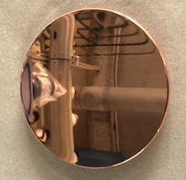
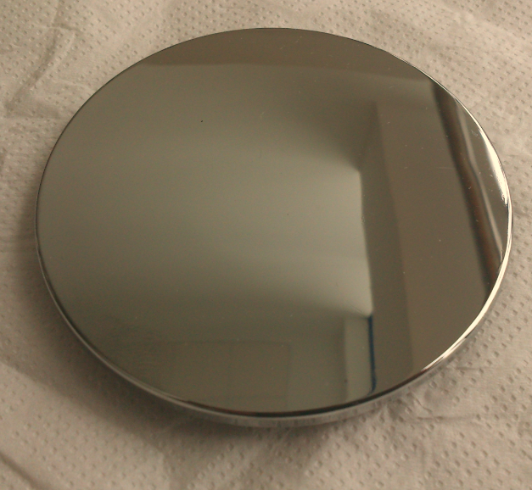
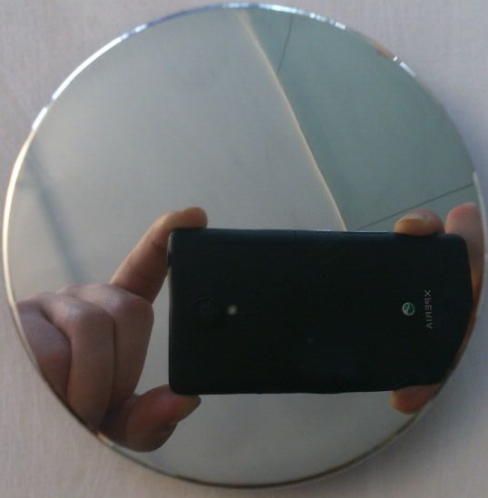
Process sequence for Cr(VI) free plating
Apply Cuptronic CBM Chemicals
CBM UV light exposure
Activated surface structure
Apply electroless Nickel
e.g. SurTec 971
Pyrophosphate Copper
e.g. SurTec 978
Acid Copper
e.g. SurTec 866
Bright Nickel
e.g. SurTec 859
Trivalent Chrome
e.g. SurTec 883 XT

Slide 37
Board members and key shareholders
Urban Fagerstedt | Chairman of the Board. Former VP R&D for Huawei Technologies Sweden and Senior Advisor to Huawei China. Urban has worked in the telecom industry 30 years. The last 15 years in development of cellular systems and in General Management positions for the last ten years.
Bo Westerberg | Board Member. Nötudden AB, Former VP at Ericsson, General Manager - Indelec (Spain), Plant Manager Philips, Senior Management Consultant - Maynard MEC AB and several Directorships.
Göran Lindahl | Former President and Chief Executive Officer at ABB, Ltd., Zurich, Switzerland, Currently member of the board of (among others) iGate Corporation (US), Patni Computer Systems Limited (India), Avinode Holding AB, LivSafe AB and IIT Board of Trustees (US, Chicago) - Previously member of the board of (among others) ABB, Anglo American, DuPont, Ericsson, Sony, Sony Ericsson, Ratos, Saab and, INGKA Holding BV (IKEA).
Hans-Göran Stennert | Board Member. IKEA Group, director of INGKA Holding BV (holding company for the IKEA Group) from 1993-2007. Chairman of the Board of INGKA Holding BV for the last ten years. Currently Chairman of the board of Eolus Vind AB.
Peter Sjöbeck | Board Member. CEO Cuptronic Technology AB,
Mikael Lövgren | Chairman of Bridgepoint's (private equity group) business in the Nordic regions. Prior to joining Bridgepoint in 2006, he spent twenty years with the Boston Consulting Group, as the founder and leader of its Nordic Operations and Nordic Healthcare Practice group. Mikael Lövgren currently sits on, among others, the board of the Karolinska University Hospital - a leading European hospital.
Notes:
The company is owned by interesting private individuals.

Slide 38
END

Slide 39
EXTRA SLIDES

Slide 40

CBM® visualized
Conventional processes
Galvanic plating to desired level
0,3-0,7 μm Electroless Cu or Ni
Activation and reduction of Pd
CBM process
Polymer structure build-up
Bare substrate

Slide 41
Evaluated Rogers PCB materials
Rogers base laminates | CBM technology peeltests (N/cm) | N/mm | Lbs/in
 | Initial values | After 20 s solder shock x3 | 105°C for 2 weeks
RO3003 | 20,2 | 16,3 | 9,6
RO3010 | 17,2 | 16,1 | 17,3
RO4835 10mil | 9,2 | 8,5 | 7,6
RO4835 10,7mil | 7,5 | 9 | 8,5
CLTE-AT RL | 13,9 | 13 | 15,6
CLTE-AT RT | 9,6 | 9,6 | 9,8
CLTE-AT ED | 10,3 | 17,2 | 10,8
RT/duroid 6002 | 25,3 | 26,1 | 26,8
RT/duroid 5880 | 22,5 | 22,6 | 14,3
TMM3 | 12,2 | 10,5 | 11,5
TMM4 | 11,1 | 11,3 | 12,9
TMM6 | 9,7 | 8.5 | 10
TMM10 | 8,9 | 8,6 | 9,4
TMM10I | 9,2 | 9 | 11,1
AS300C | 26,7 | 20,7 | 31,1
More or less base material breach
Only base material breach

Slide 42
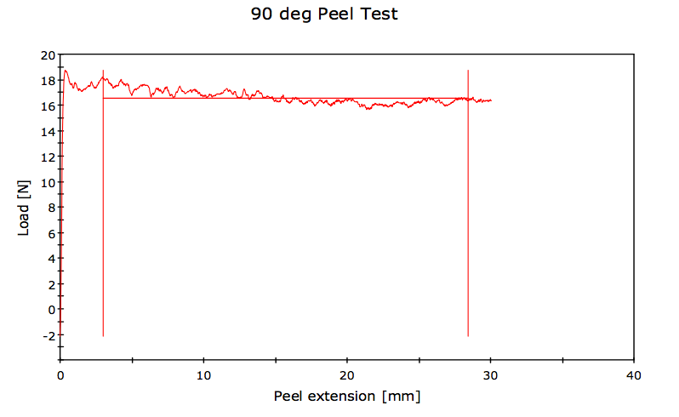
Adhesion test example
Material: PA6 (Minlon 73M40), 25 µm Cu strip
Pull rate: 25.00 mm/min
Strip Width: 6.35 mm
Surface: Rz = 0,15 µm
Peel Test According to IPC 650 Standard
Average Load/Width at average value (100 peaks and troughs) 26.1 N/cm
Average Load at average value (100 peaks and troughs) 16.6 N

